Slide 1
Genome Literacy Workshop
Elisabeth Busch-Nentwich
& Pavol Kramár
Queen Mary University of London, UK

Slide 2
Why genome literacy?
Saves time and effort
Ensembl collates a lot of published information
Knowing how to find that can (at least partially) replace trawling through papers
Better experimental design for gene editing experiments
Understand gene structure
Understand splice variants and expression behaviour
Download data without coding
Sequence, phenotypes, gene ontology annotations
Customise genome browser
Switch on relevant tracks, upload your own data

Slide 3
Learning Outcomes
Understand Ensembl as a database
basics of default data
investigating homology
Find and switch on optional features
find your gene and its associated data
Download gene and genome data
key tools to use
Upload and display your own data

Slide 4
Workshop structure
Lecture sections
Introduce background information
Show examples
Slides for future reference
Small exercises
In lecture sections
I will point out when to switch to browser
Large exercises
Designed to be more challenging
Cover all tools and features we introduce
Your questions
Email me so that we can work through them on Day 2

Slide 5
Workshop structure
Day 1
Part 1
Zebrafish genome basics
Ensembl basics
Nomenclature (Gene names, IDs, etc...)
Assembly vs annotation
Part 2
Configuring Ensembl tracks
Ensembl “Gene” view
Comparative genomics
Homework
Email me your questions so that we can work through them on Day 2
Finish exercises
Day 2
Part 3
BioMart
Other tools (Variant Effect Predictor, etc...)
Custom tracks
Your questions

Slide 6
Part 1
Zebrafish Genome Project
Ensembl
Finding your gene
Gene name and IDs
Manual and automatic annotation
Ensembl “Region” view

Slide 7
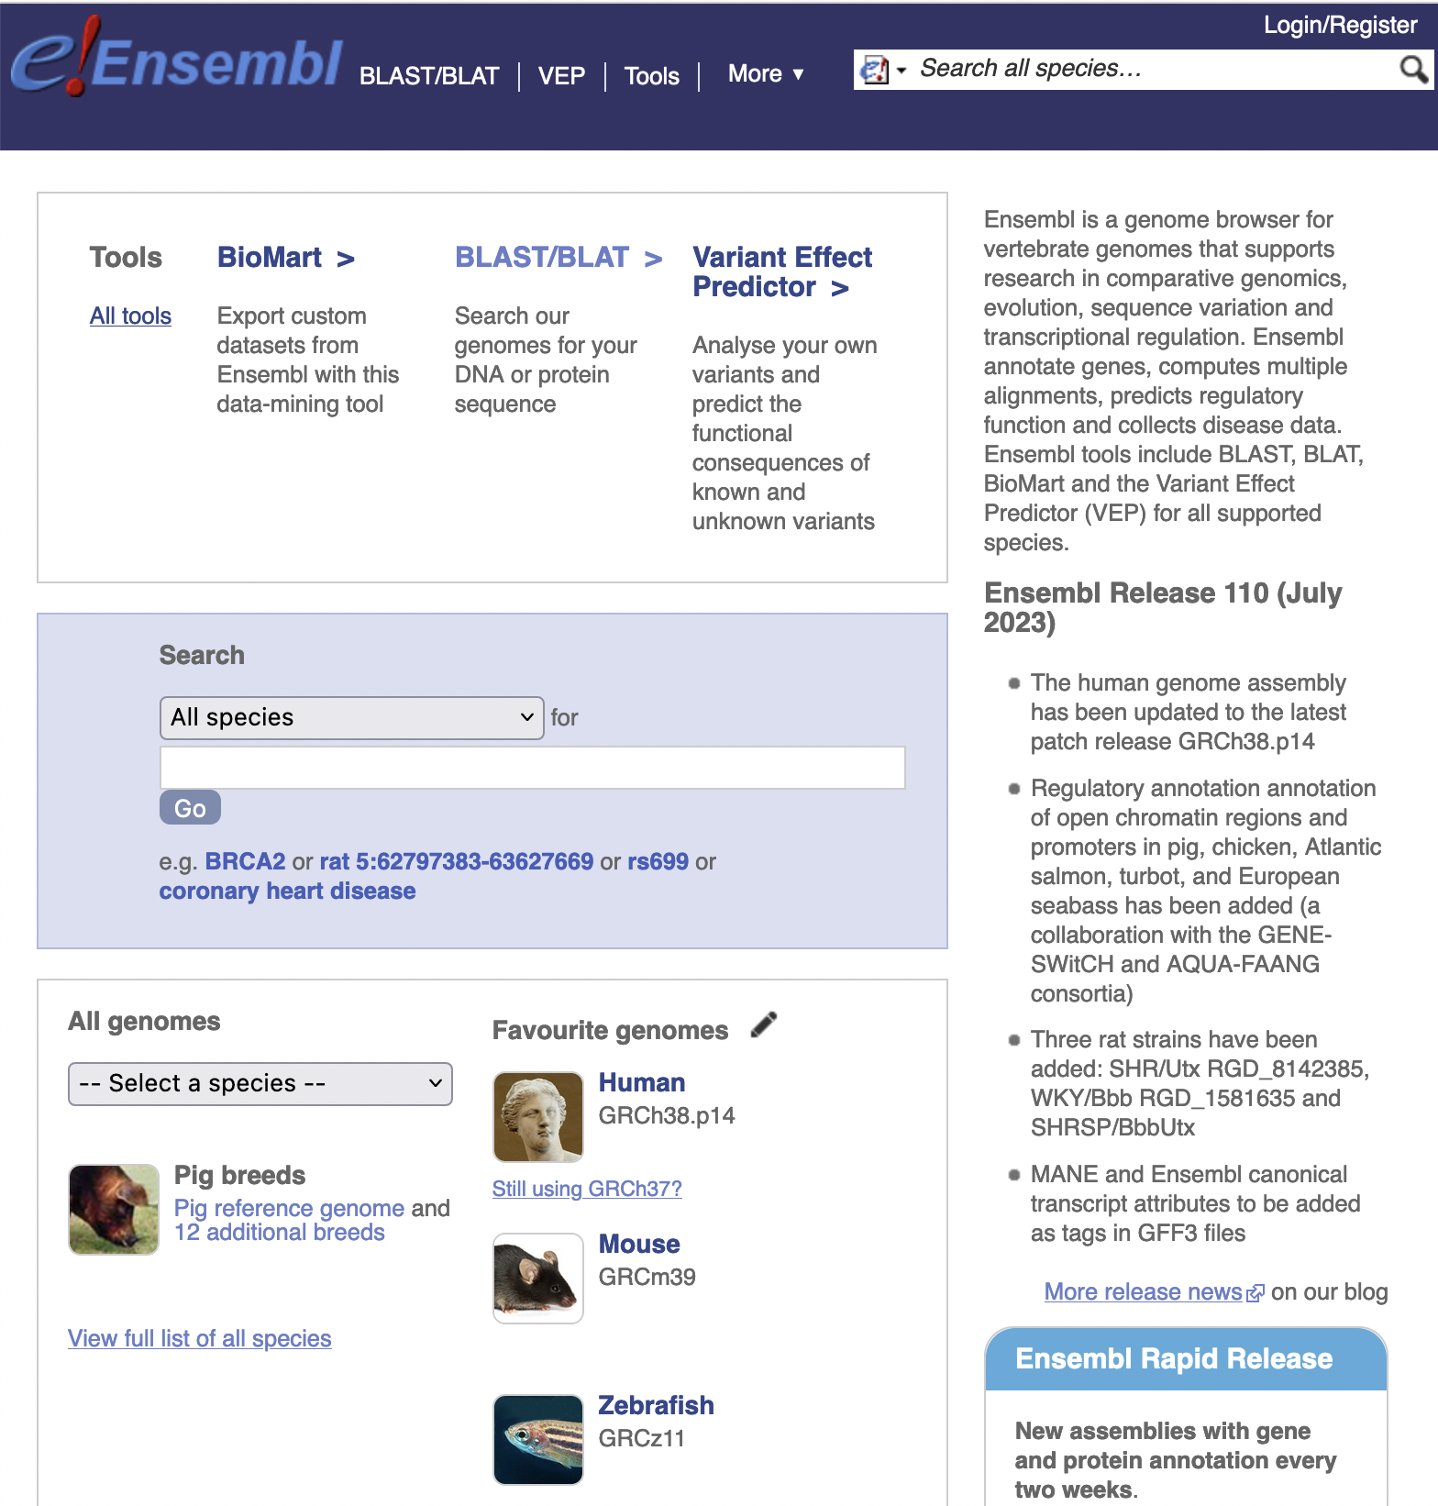
Ensembl
Most examples from Ensembl (we are biased!)
Probably most widely used genome browser amongst zebrafish researchers
Primary source of zebrafish annotation (UCSC imports Ensembl annotation)
Currently Ensembl version 110 (July 18th)
New releases 3 or 4 times / year
Zebrafish annotation largely static between releases
But naming and homology updated (+ new functionality)
Notes:
Note zebrafish the third most commonly used organism

Slide 8
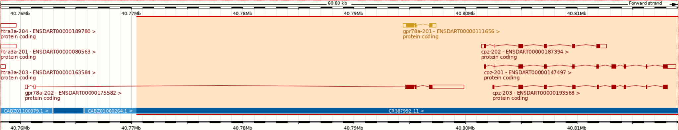
Zebrafish Genome
GRCz11 (danRer11) - latest assembly, released in 2017
Sequencing strategy:
90% clone by clone sequencing
High quality
10% whole genome shotgun sequencing
Lower quality
Fills gaps between clones
Identified by accessions beginning with CABZ
Notes:
Note good transcript on clone sequence, but spindly transcript with intron in 5’ UTR on WGS sequence

Slide 9
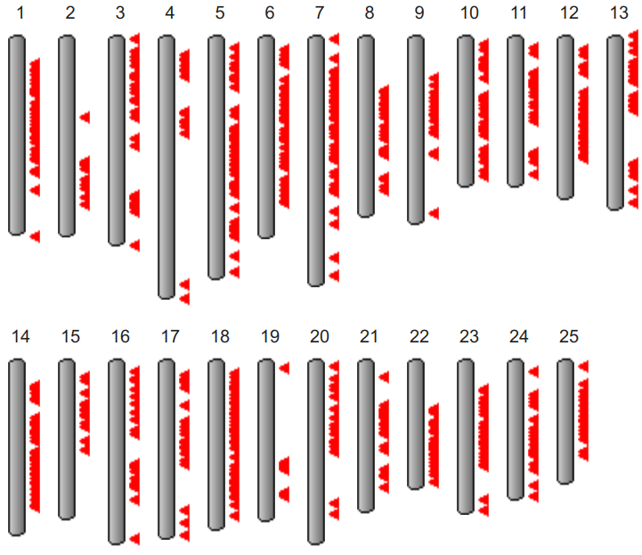
Zebrafish Genome History
Genome project started in 2001 at Sanger Institute
Initially sequenced pool of Tübingen zebrafish
But zebrafish very polymorphic compared to humans
Too much variation to join clones, so lots of gaps
+ same region represented by 2+ clones, leading to artificial duplication
Later used double haploid Tübingen fish for some clones and most WGS
Only 925 gaps between scaffolds and N50 > 7 Mbp
GRCz11 contains alternative scaffolds
From https://www.ncbi.nlm.nih.gov/grc/zebrafish
When downloading sequence from Ensembl FTP site, "toplevel" includes alternative sequence, but "primary_assembly" doesn't and is probably what you want
Notes:
N50 = measure of how contiguous genome is (50% of sequence is in contigs longer than 7 Mbp)
Ideogram shows locations of alternative scaffolds

Slide 10
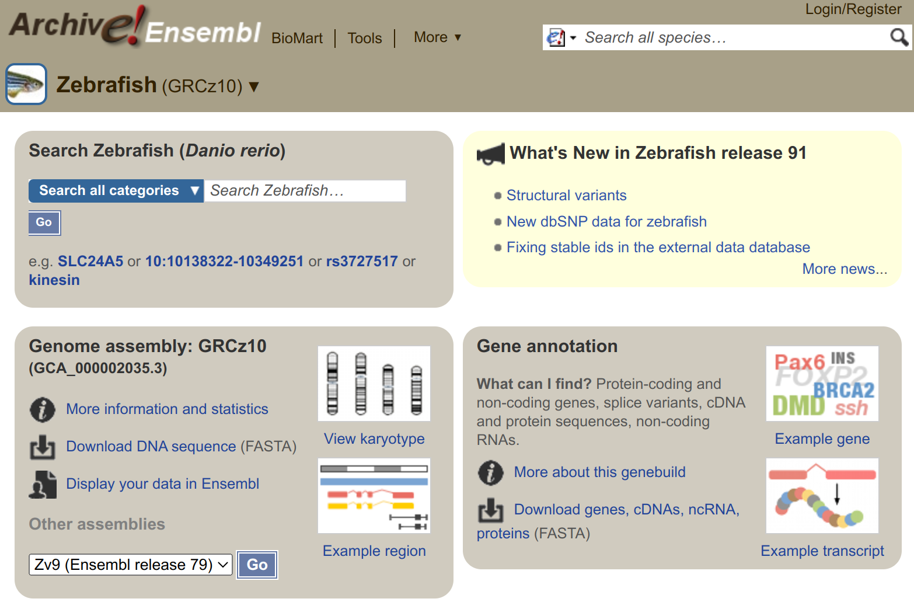
Older Assemblies
Previous assemblies available in Ensembl archives: www.ensembl.org/info/website/archives/assembly.html
GRCz10 / danRer10: http://e91.ensembl.org/
Zv9 / danRer7: http://e77.ensembl.org/
Zv8 / danRer6: http://e54.ensembl.org/
Even older assemblies available in UCSC
Numbering coordinated when GRC (Genome Reference Consortium) took over managing zebrafish assembly from Sanger Institute
Notes:
Note Ensembl archives always brown colour

Slide 11

Ensembl Mirrors
Mirrors: www.ensembl.org/info/about/mirrors.html
Main site (UK): www.ensembl.org
US East mirror: useast.ensembl.org
Most often slow due to chosen tracks though

Slide 12
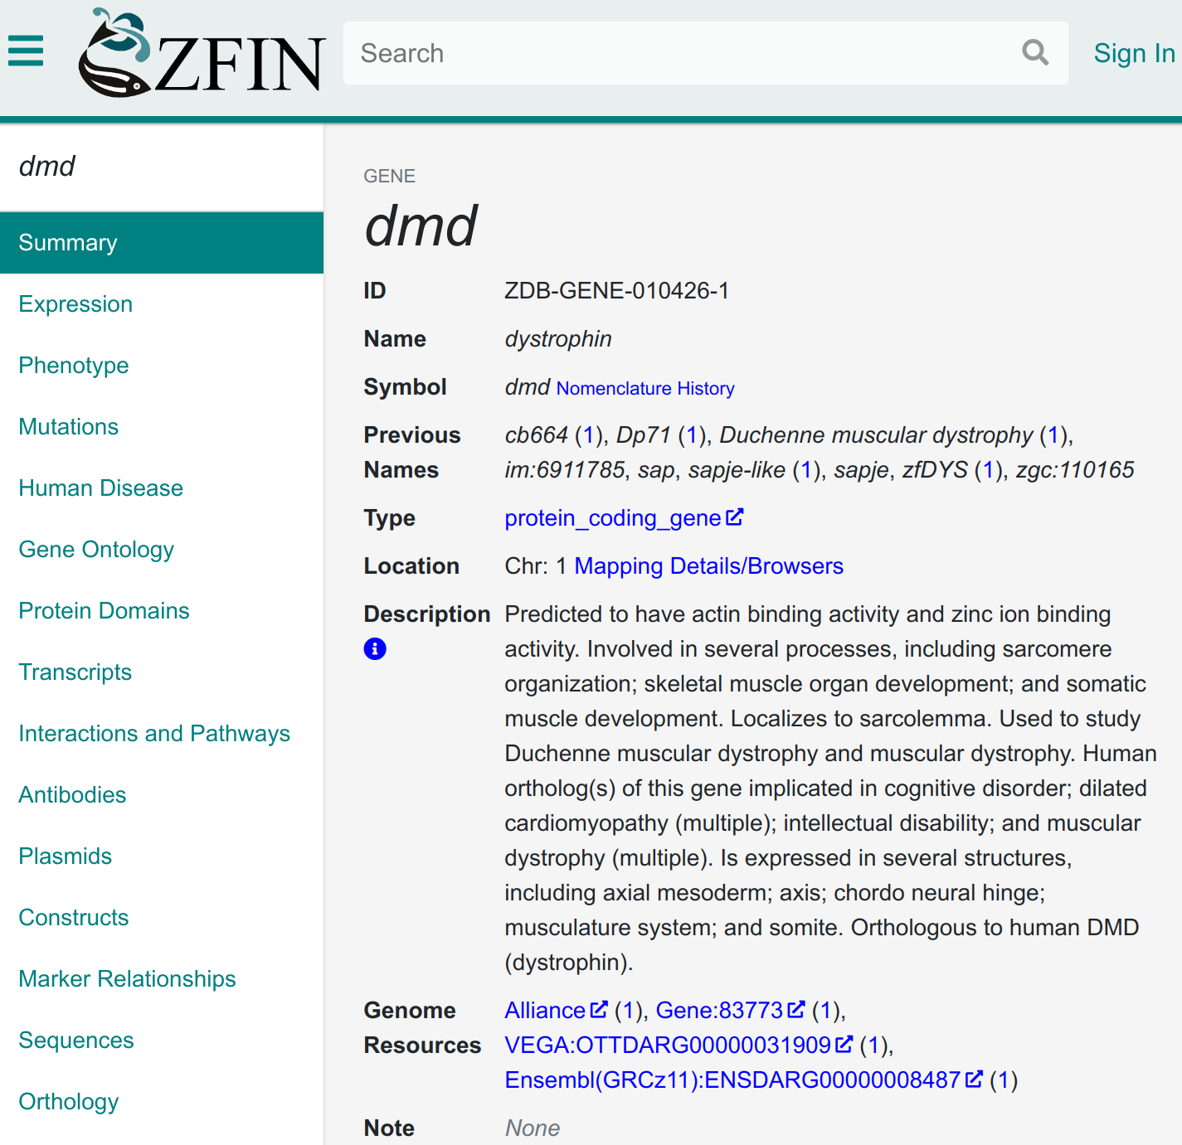
Finding Your Gene
Follow link from ZFIN

Slide 13
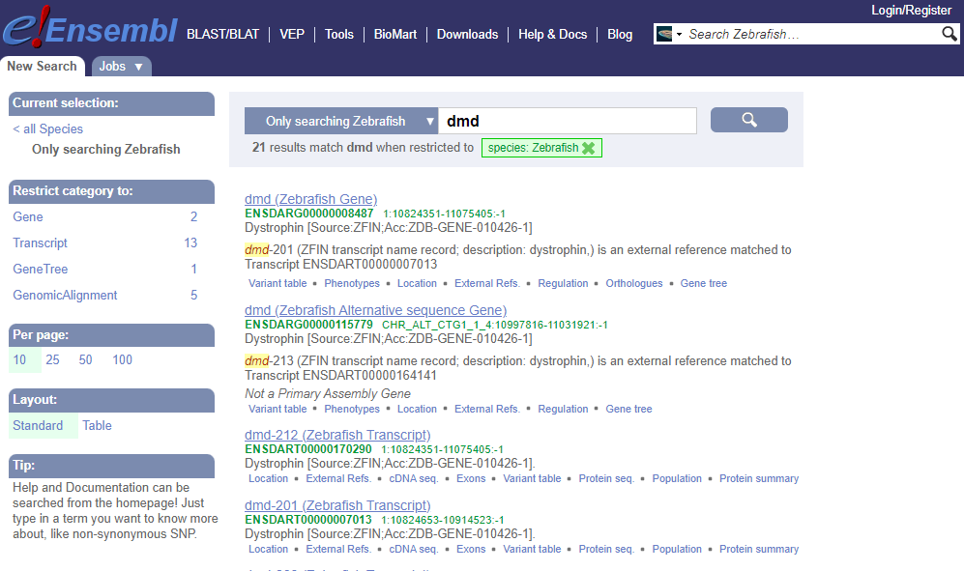
Finding Your Gene
Follow link from ZFIN
Search by gene name on Ensembl (or old name or mutant name)
Notes:
Note searches gene name, descriptions and synonyms. Synonyms can be old names for genes and can be confusing if names have swapped.

Slide 14
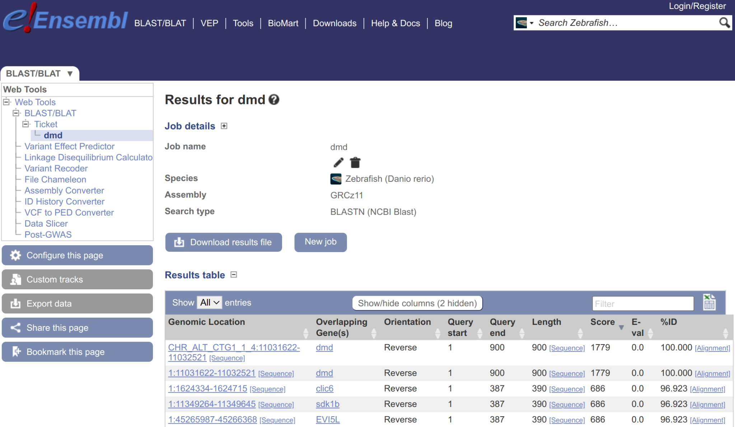
Finding Your Gene
Follow link from ZFIN
Search by gene name on Ensembl (or old name or mutant name)
Search using BLAST or BLAT on Ensembl
BLAT is faster
BLAST finds more distant alignments + alternative scaffolds
No BLAST/BLAT on Ensembl archive sites but can use BLAT on UCSC

Slide 15
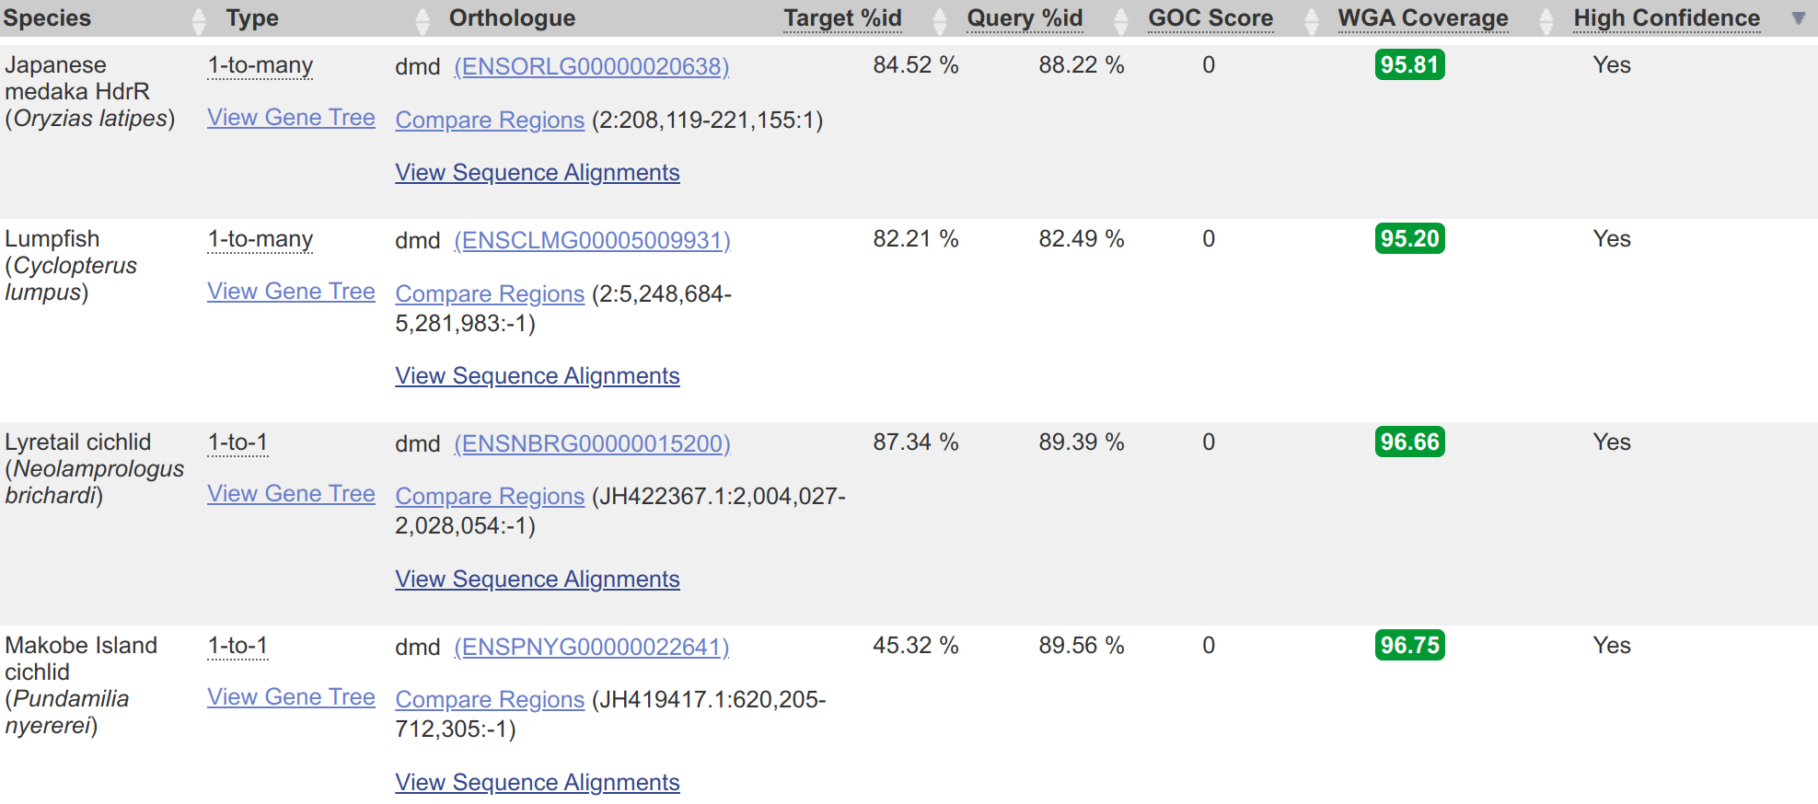
Finding Your Gene
Follow link from ZFIN
Search by gene name on Ensembl (or old name or mutant name)
Search using BLAST or BLAT on Ensembl
BLAT is faster
BLAST finds more distant alignments + alternative scaffolds
No BLAST/BLAT on Ensembl archive sites but can use BLAT on UCSC
Check gene correct by checking orthologues and/or synteny

Slide 16
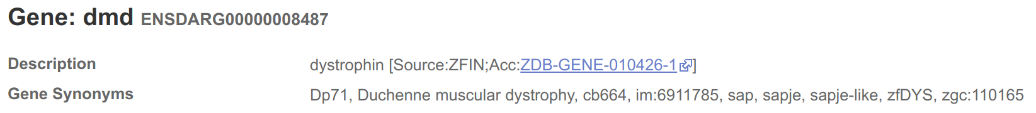
Gene Names
Names assigned to Ensembl genes automatically based on sequence similarity
Mistakes are possible
Names can change
ZFIN gene symbols (i.e. the name assigned by ZFIN) are preferred, but other databases are also used, e.g. HGNC (HUGO* Gene Nomenclature Committee) and miRBase
Description indicates source of name
Genes without a match are given a name based on the sequence used to identify them, e.g AL645792.1 (clone) or CABZ01052570.1 (WGS)
*HUGO: Human Genome Organization

Slide 17
Stable IDs
Best to use stable IDs
e.g. ENSDARG00000028213 (ttn.2 or ttna)
ENS = Ensembl
Notes:
ttna was changed to ttn.2 because the a indicates an ohnolog whereas they actually resulted from a tandem duplication (both on chromosome 9)

Slide 18
Stable IDs
Best to use stable IDs
e.g. ENSDARG00000028213 (ttn.2 or ttna)
ENS = Ensembl
DAR = Danio rerio

Slide 19
Stable IDs
Best to use stable IDs
e.g. ENSDARG00000028213 (ttn.2 or ttna)
ENS = Ensembl
DAR = Danio rerio
G = Gene (also T for Transcript, P for Peptide and E for exon)

Slide 20
Stable IDs
Not completely stable, if annotation or underlying assembly changes
Stable IDs have versions, e.g. ENSDARG00000058767.4
Version number of ENSDARG increases if transcripts change
Version number of ENSDART increases if splicing, chromosome or sequence of transcript change
Version number of ENSDARP increases if peptide's sequence changes
Version number of ENSDARE increases if exon's sequence changes
Can also be removed, e.g. searching for ENSDARG00000058767

Slide 21
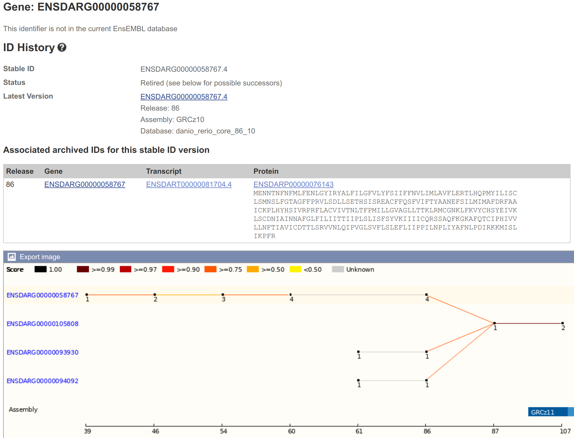
Stable IDs
Not completely stable, if annotation or underlying assembly changes
Stable IDs have versions, e.g. ENSDARG00000058767.4
Version number of ENSDARG increases if transcripts change
Version number of ENSDART increases if splicing, chromosome or sequence of transcript change
Version number of ENSDARP increases if peptide's sequence changes
Version number of ENSDARE increases if exon's sequence changes
Can also be removed, e.g. searching for ENSDARG00000058767
Notes:
Note three genes merged into one in Ensembl 87 (GRCz10)
From https://www.ensembl.org/Danio_rerio/Gene/Idhistory?g=ENSDARG00000058767

Slide 22
Stable IDs
Not completely stable, if annotation or underlying assembly changes
Stable IDs have versions, e.g. ENSDARG00000058767.4
Version number of ENSDARG increases if transcripts change
Version number of ENSDART increases if splicing, chromosome or sequence of transcript change
Version number of ENSDARP increases if peptide's sequence changes
Version number of ENSDARE increases if exon's sequence changes
Can also be removed, e.g. searching for ENSDARG00000058767
Can use www.ensembl.org/Danio_rerio/Tools/IDMapper to convert older IDs to what they map to currently in Ensembl
Relevance: Gene IDs from older publications!

Slide 23
Stable IDs
Not completely stable, if annotation or underlying assembly changes
Stable IDs have versions, e.g. ENSDARG00000058767.4
Version number of ENSDARG increases if transcripts change
Version number of ENSDART increases if splicing, chromosome or sequence of transcript change
Version number of ENSDARP increases if peptide's sequence changes
Version number of ENSDARE increases if exon's sequence changes
Can also be removed, e.g. searching for ENSDARG00000058767
Can use www.ensembl.org/Danio_rerio/Tools/IDMapper to convert older IDs to what they map to currently in Ensembl
Mini-exercise: Check whether your favourite genes have had stable ID changes. What’s the ENSDARG version number? (Hint: look for your gene’s ID history)

Slide 24
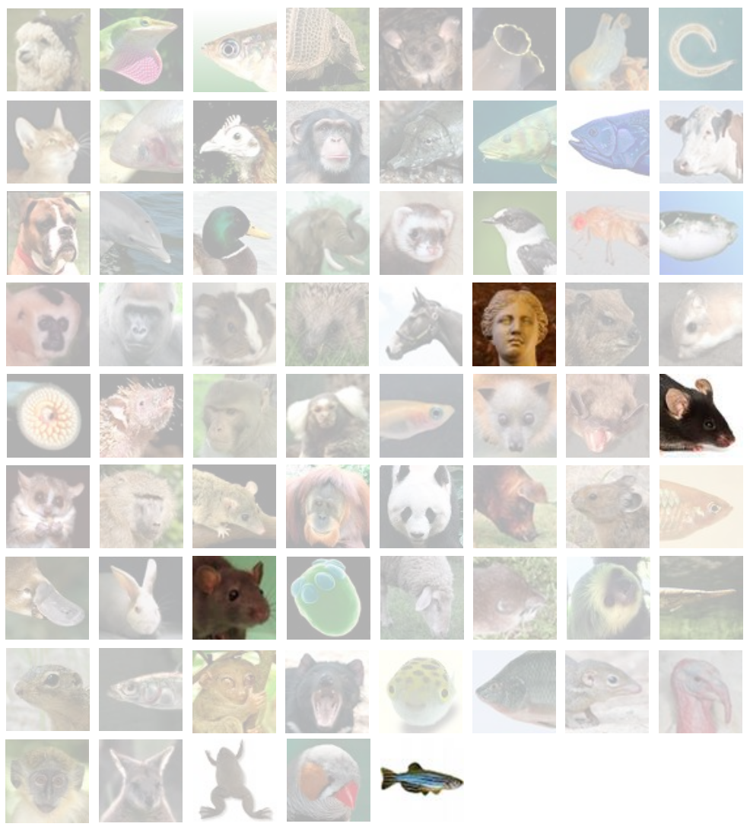
Gene Annotation
Zebrafish (+ human, mouse, rat) has manual and automatic gene annotation
Other 300+ genomes in Ensembl only have automatic annotation
www.ensembl.org/info/about/species.html
From Ensembl training materials, CC BY 4.0 license

Slide 25
Manual Annotation
Gold standard
Uses information from databases and publications
More accurate for tricky areas:
e.g. UTRs, splice sites, single exon transcripts
Slower and more expensive
Thorough, but leads to inclusion of transcripts that may not be representative (e.g. low expression)
Only clones manually annotated
From Ensembl training materials, CC BY 4.0 license
Notes:
Note transcripts included that may just represent transcription problems and have very low expression
Note not all of the genome - or even all clones - has been manually annotated

Slide 26
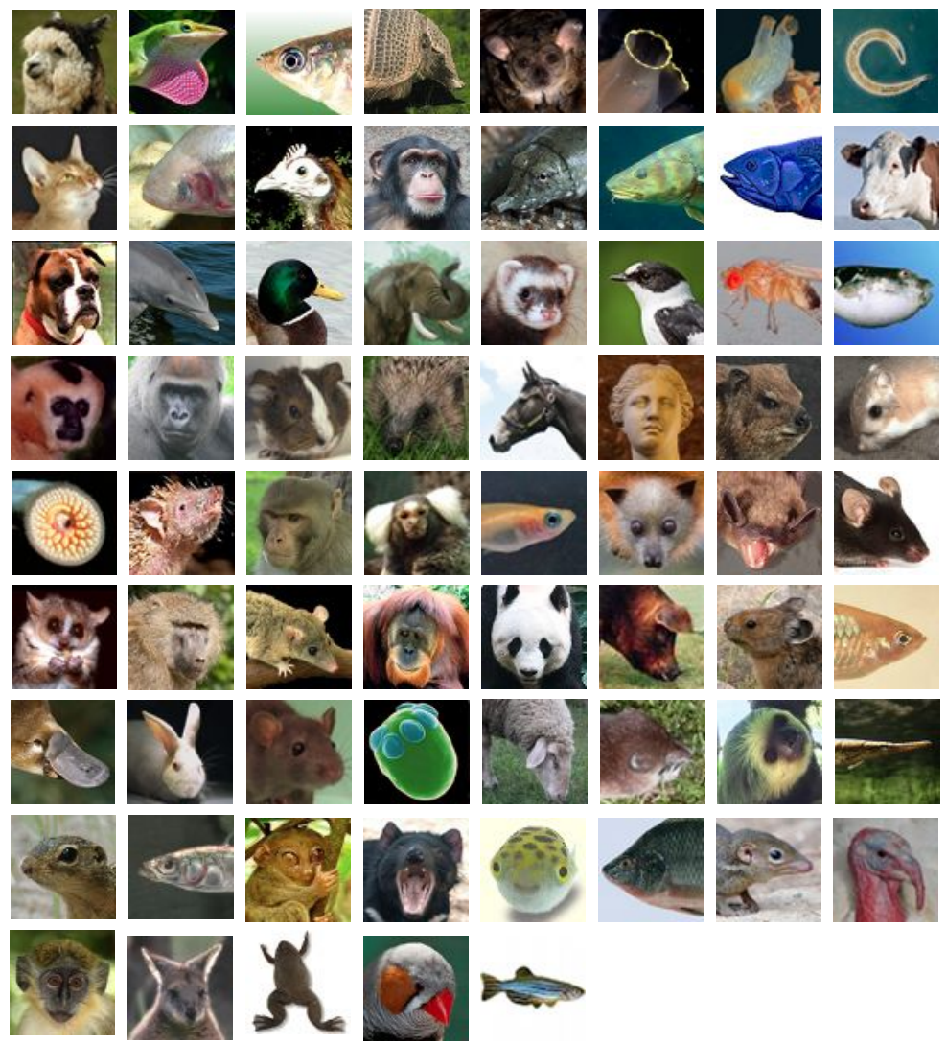
Automatic Annotation
Faster
Uses evidence from sequences deposited in ENA/GenBank/DDBJ and UniProt proteins
Overview:
Identify repeats and low complexity sequence with RepeatMasker, Dust and TRF
Run GENSCAN to identify ab initio gene predictions
Align UniProt proteins to GENSCAN predictions, prioritising zebrafish proteins or those from closely related or well annotated species
Make gene models using Genewise
Align cDNAs, ESTs and RNA-seq to annotate UTRs and make RNA-seq gene models
Collapse redundant transcripts and cluster into genes, prioritising manual annotation but including automatic annotation if different splicing
Identify pseudogenes by looking for genes with frameshifts / repeats
Identify processed pseudogenes by looking for multi-exon equivalent
From Ensembl training materials, CC BY 4.0 license
Notes:
Note still took months to run when we last ran automatic annotation for zebrafish genebuild
Note genes can be missing if sequence not deposited
Note PDF in supplemental materials describing gene annotation method for GRCz11
See https://www.ensembl.org/info/genome/genebuild/automatic_coding.html for more info, including on pseudogenes

Slide 27
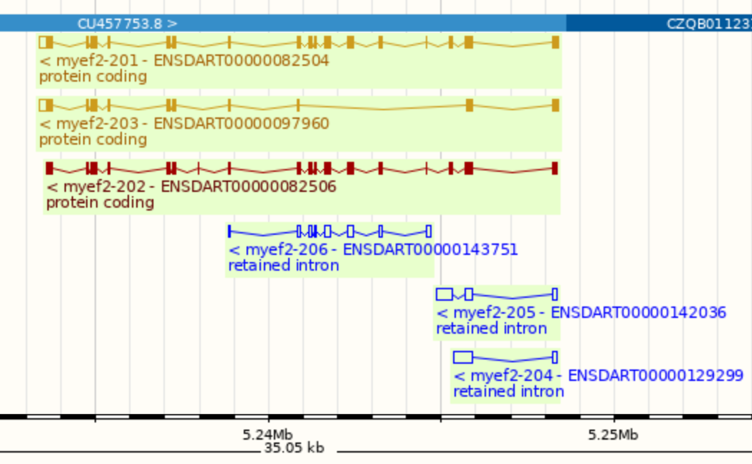
Merged Annotation
Golden: Identical manual and automatic annotation
Red: Protein-coding transcript from automatic annotation
Blue: Non-coding transcript
Filled box: Coding exon
Non-filled box: Non-coding exon
In reality, would not trust these retained intron transcripts unless shown to have comparable expression levels
Notes:
From https://www.ensembl.org/Danio_rerio/Gene/Summary?db=core;g=ENSDARG00000059398

Slide 28
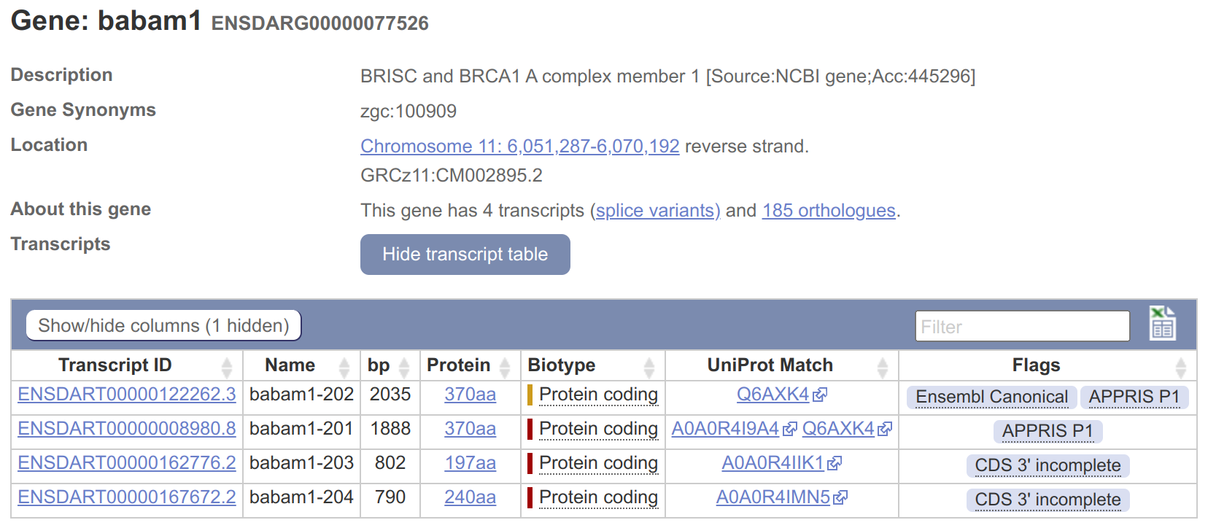
Which Transcript?
Often multiple transcripts
Best transcript for experiments?
Golden transcript is a good bet
Ensembl Canonical transcript is, on balance, most conserved, most expressed, longest CDS (coding sequence) and in other databases
APPRIS combines protein structure, important residues and homology to identify a principal isoform - APPRIS P1
Notes:
Note PDF in supplemental materials describing how APPRIS select isoforms
From https://www.ensembl.org/Danio_rerio/Gene/Summary?db=core;g=ENSDARG00000077526
See https://www.ensembl.org/info/genome/genebuild/transcript_quality_tags.html for more info

Slide 29
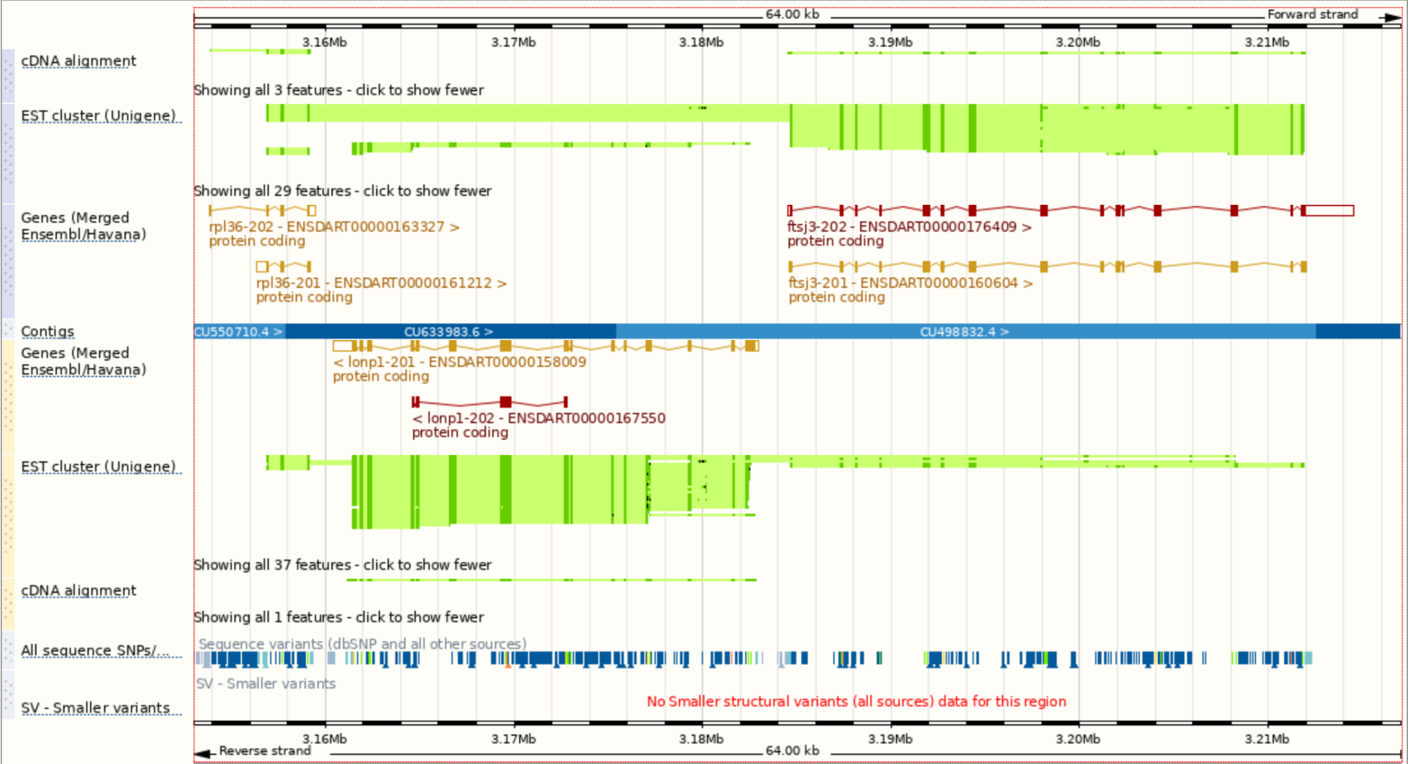
"Region in detail" Demo
Go to "22:3153000-3217000"
4 clones
2 genes on +
1 gene on -
Manual + automatic annotation
cDNA + EST tracks
Variant tracks
Notes:
Note: Sequence: 4 clones; 2 genes on forward strand, 1 on reverse; some manual annotation (gold) and some automatic (red); cDNA (correct strand) and EST (both strands) tracks supporting genes; variant tracks
From https://www.ensembl.org/Danio_rerio/Location/View?r=22%3A3153000-3217000

Slide 30
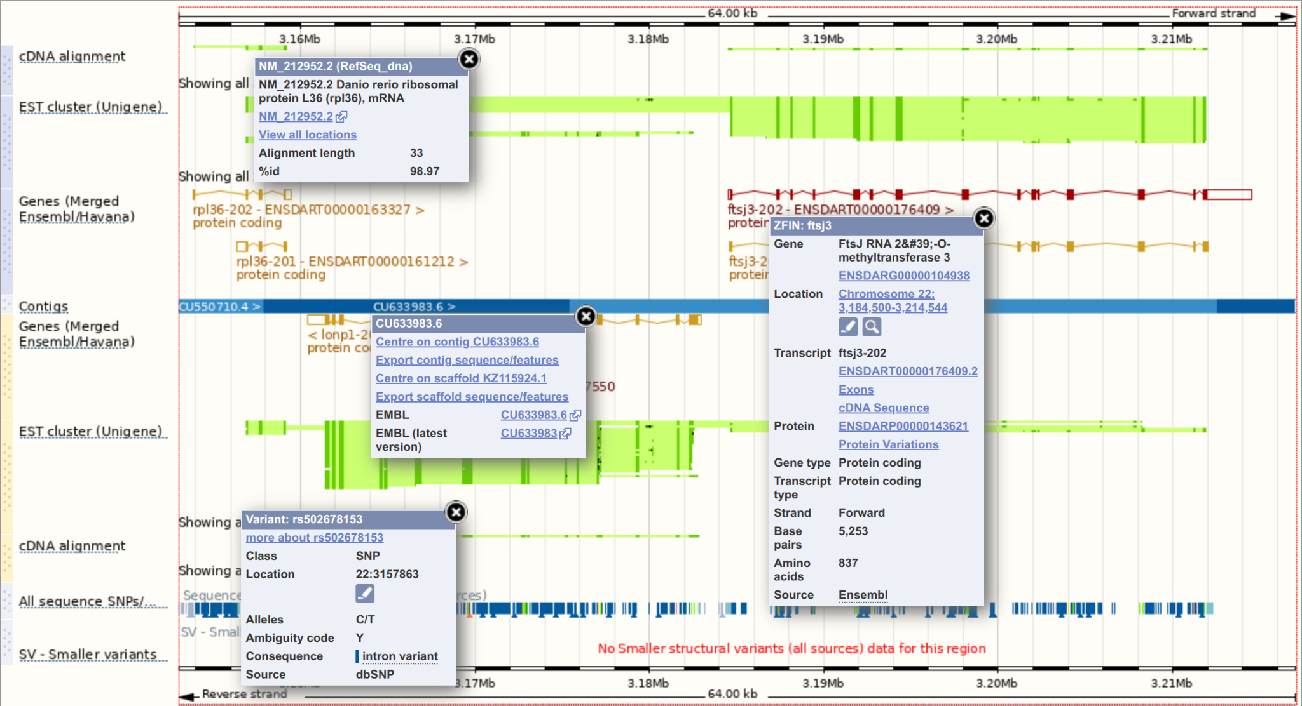
"Region in detail" Demo
Go to "22:3153000-3217000"
4 clones
2 genes on +
1 gene on -
Manual + automatic annotation
cDNA + EST tracks
Variant tracks
Notes:
Note click on any feature for more info
From https://www.ensembl.org/Danio_rerio/Location/View?r=22%3A3153000-3217000

Slide 31
Quiz time!

Slide 32
Exercise 1
Do Exercise 1 - “exploring the genome”
Covers:
Region view
BLAST/BLAT
Archive sites
Go to mbl2023.buschlab.org

Slide 33
Part 1 summary
Zebrafish genome basics
Ensembl basics
Nomenclature (Gene names, IDs, etc...)
Assembly vs annotation
Learning outcomes:
Understanding gene features for experiments, e.g. CRISPR, ISHs
Distinguish between annotation and assembly, gene versions
Being able to switch between releases
Judging which transcripts/ gene features are reliable
Any questions?

Slide 34
Part 2
Configuring Ensembl tracks
Ensembl “Gene” view
Comparative genomics
But first, back to the region we were looking at before the exercises: "22:3153000-3217000"

Slide 35
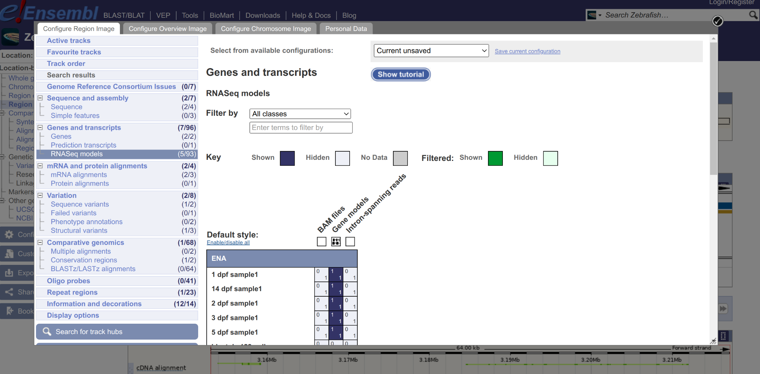
"Configure this page" Demo
Go to "22:3153000-3217000" and click “Configure this page”
Notes:
Go to “Configure this page”; under Genes turn on RefSeq GFF3 (Expanded with labels); under RNASeq models turn on Gene models for top 5 (click and drag); under Repeat regions turn on Type II Transposons (Compact)
Skip ahead to next slide to introduce RefSeq
Warning: Seem to have to select both Type II Transposons options to guarantee it works!
From https://www.ensembl.org/Danio_rerio/Location/View?r=22%3A3153000-3217000

Slide 36
RefSeq Aside
NCBI’s annotated and curated database of reference sequences, including transcripts and proteins
Accessions starting X are “Model RefSeq” predictions from automatic genome annotation
Accessions starting N are “Known RefSeq” from manually curated cDNA and EST data
Accessions starting NM & XM indicate mRNA; NP & XP are proteins

Slide 37
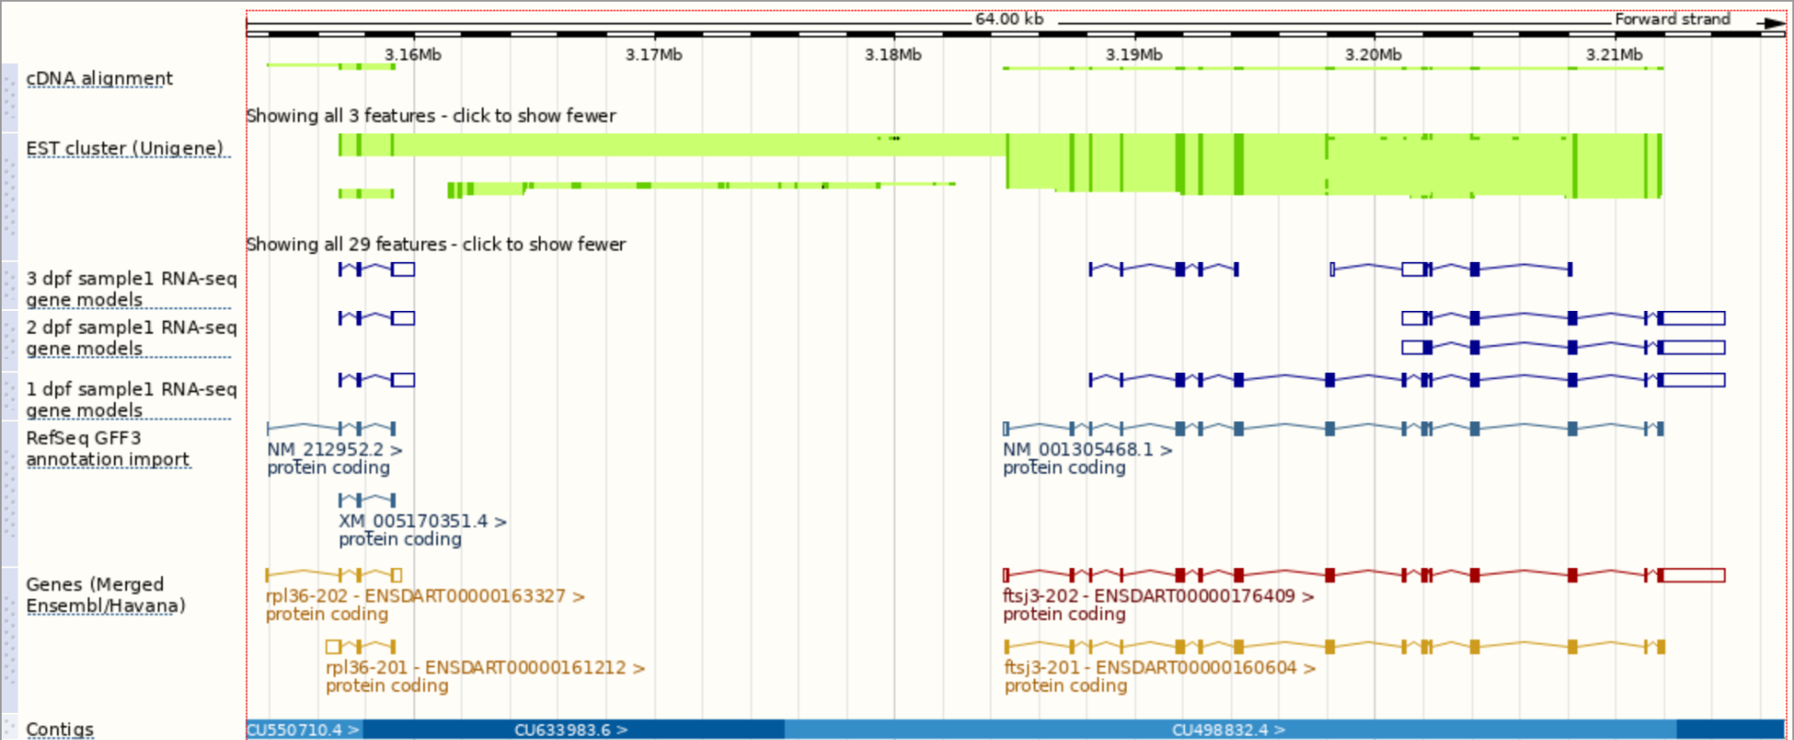
"Configure this page" Demo
Go to "22:3153000-3217000" and click “Configure this page”
Notes:
Note RefSeq annotation agrees and RNASeq model indicates longer 3' UTR for rpl36
Note wouldn’t necessarily trust retained intron at 5’ end of ftsj3 RNA-seq models since not supported by other models and may just reflect genomic DNA contamination or 3’ bias of RNA-seq
From https://www.ensembl.org/Danio_rerio/Location/View?r=22%3A3153000-3217000

Slide 38
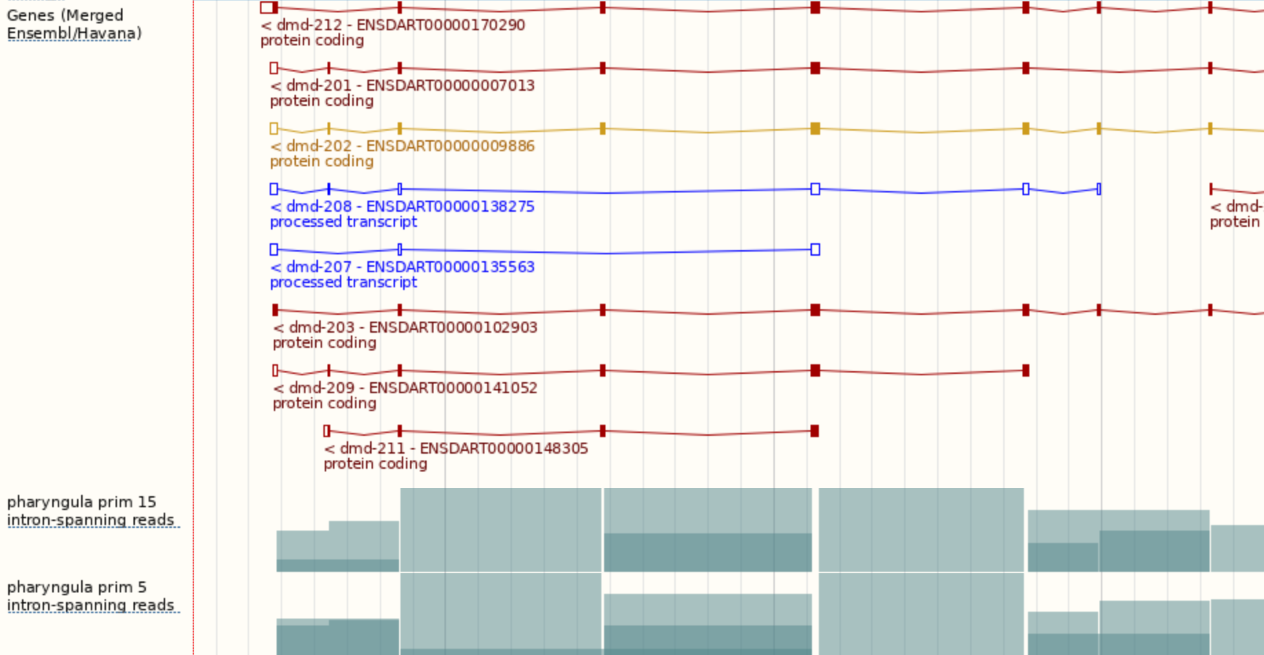
"Configure this page" Demo
Go to "1:10822281-10882903" and click “Configure this page”
Under “RNASeq models”, turn on “Intron-spanning reads” for “pharyngula prim 5” and “pharyngula prim 15”
Notes:
From https://www.ensembl.org/Danio_rerio/Location/View?db=core;r=1:10822281-10882903

Slide 39
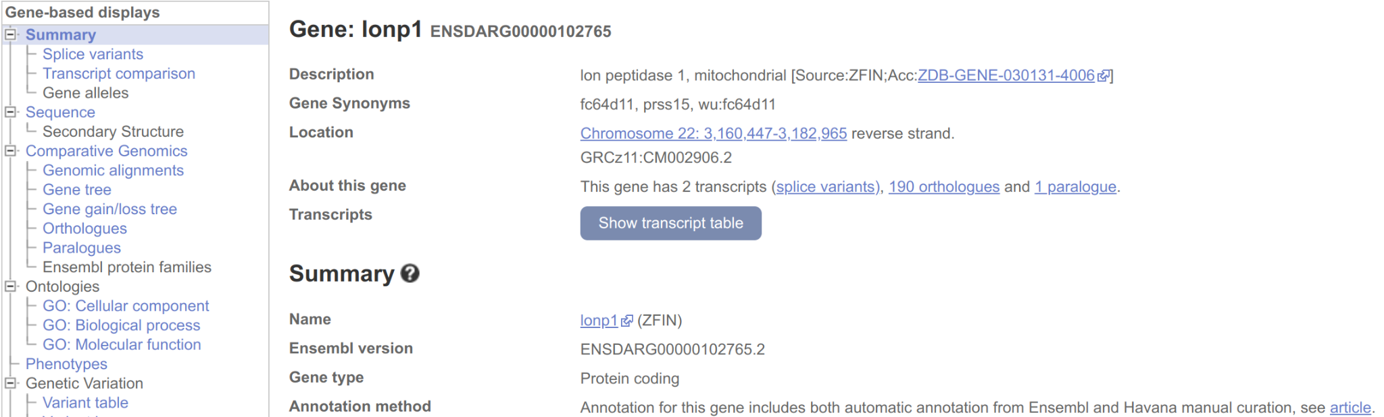
"Gene" Demo - Summary
Go to ENSDARG00000102765
Notes:
From https://www.ensembl.org/Danio_rerio/Gene/Summary?align=2007;db=core;g=ENSDARG00000102765;r=22:3160447-3182965

Slide 40
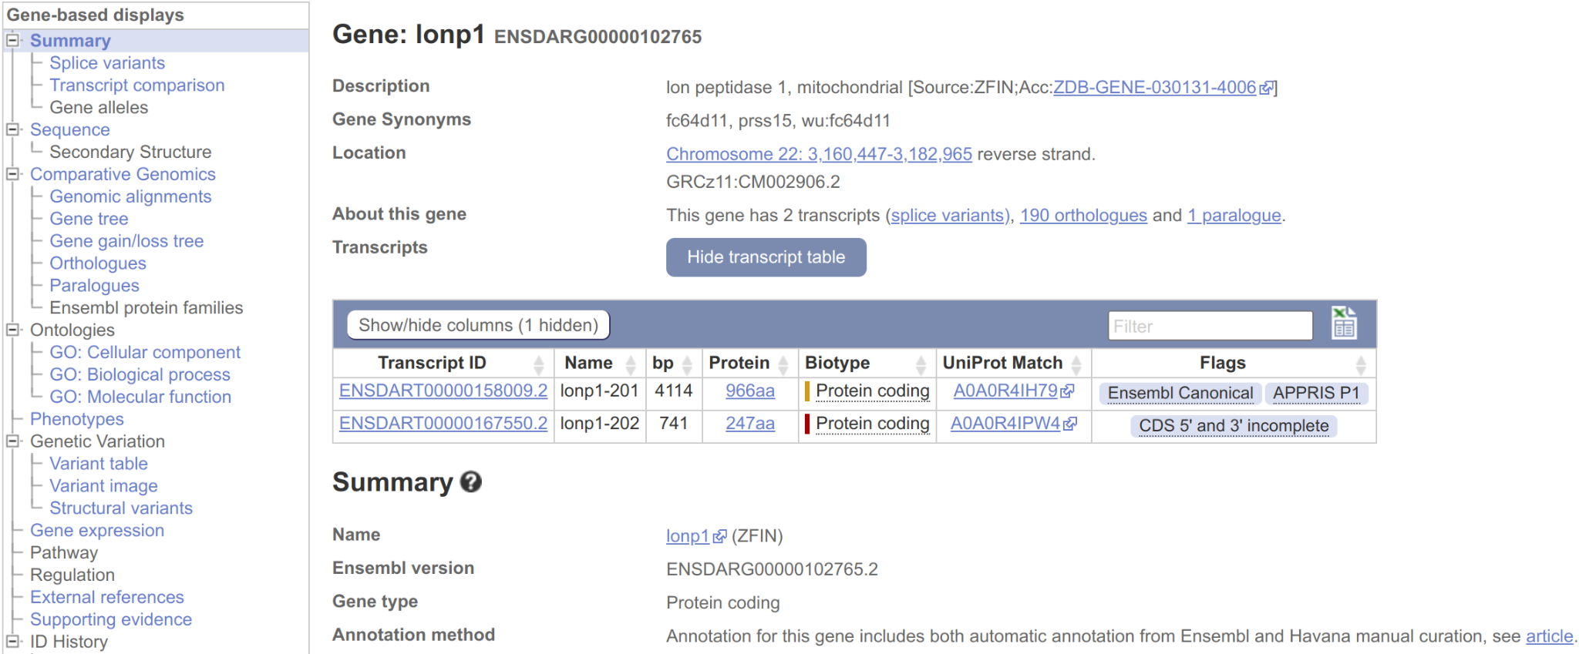
"Gene" Demo - Transcript Table
Go to ENSDARG00000102765 and click on “Show transcript table”
Notes:
From https://www.ensembl.org/Danio_rerio/Gene/Summary?align=2007;db=core;g=ENSDARG00000102765;r=22:3160447-3182965

Slide 41
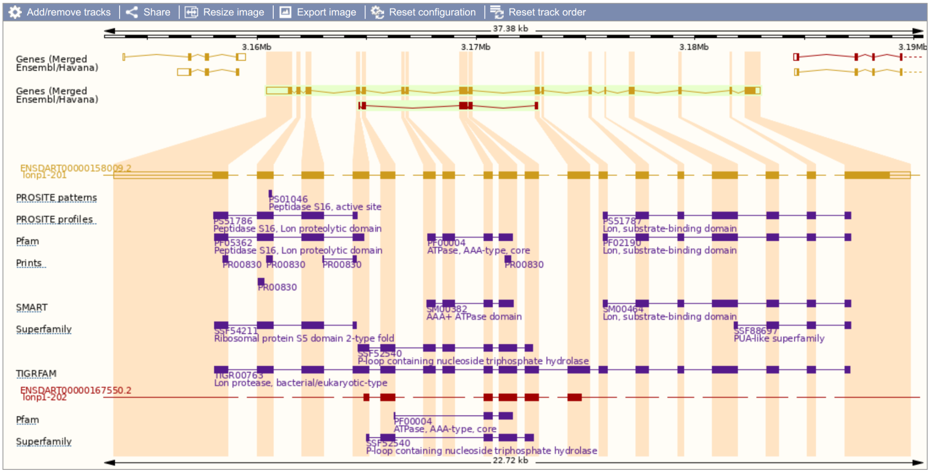
"Gene" Demo - Splice Variants
Go to ENSDARG00000102765 and click on “Splice variants”
Notes:
From https://www.ensembl.org/Danio_rerio/Gene/Summary?align=2007;db=core;g=ENSDARG00000102765;r=22:3160447-3182965

Slide 42
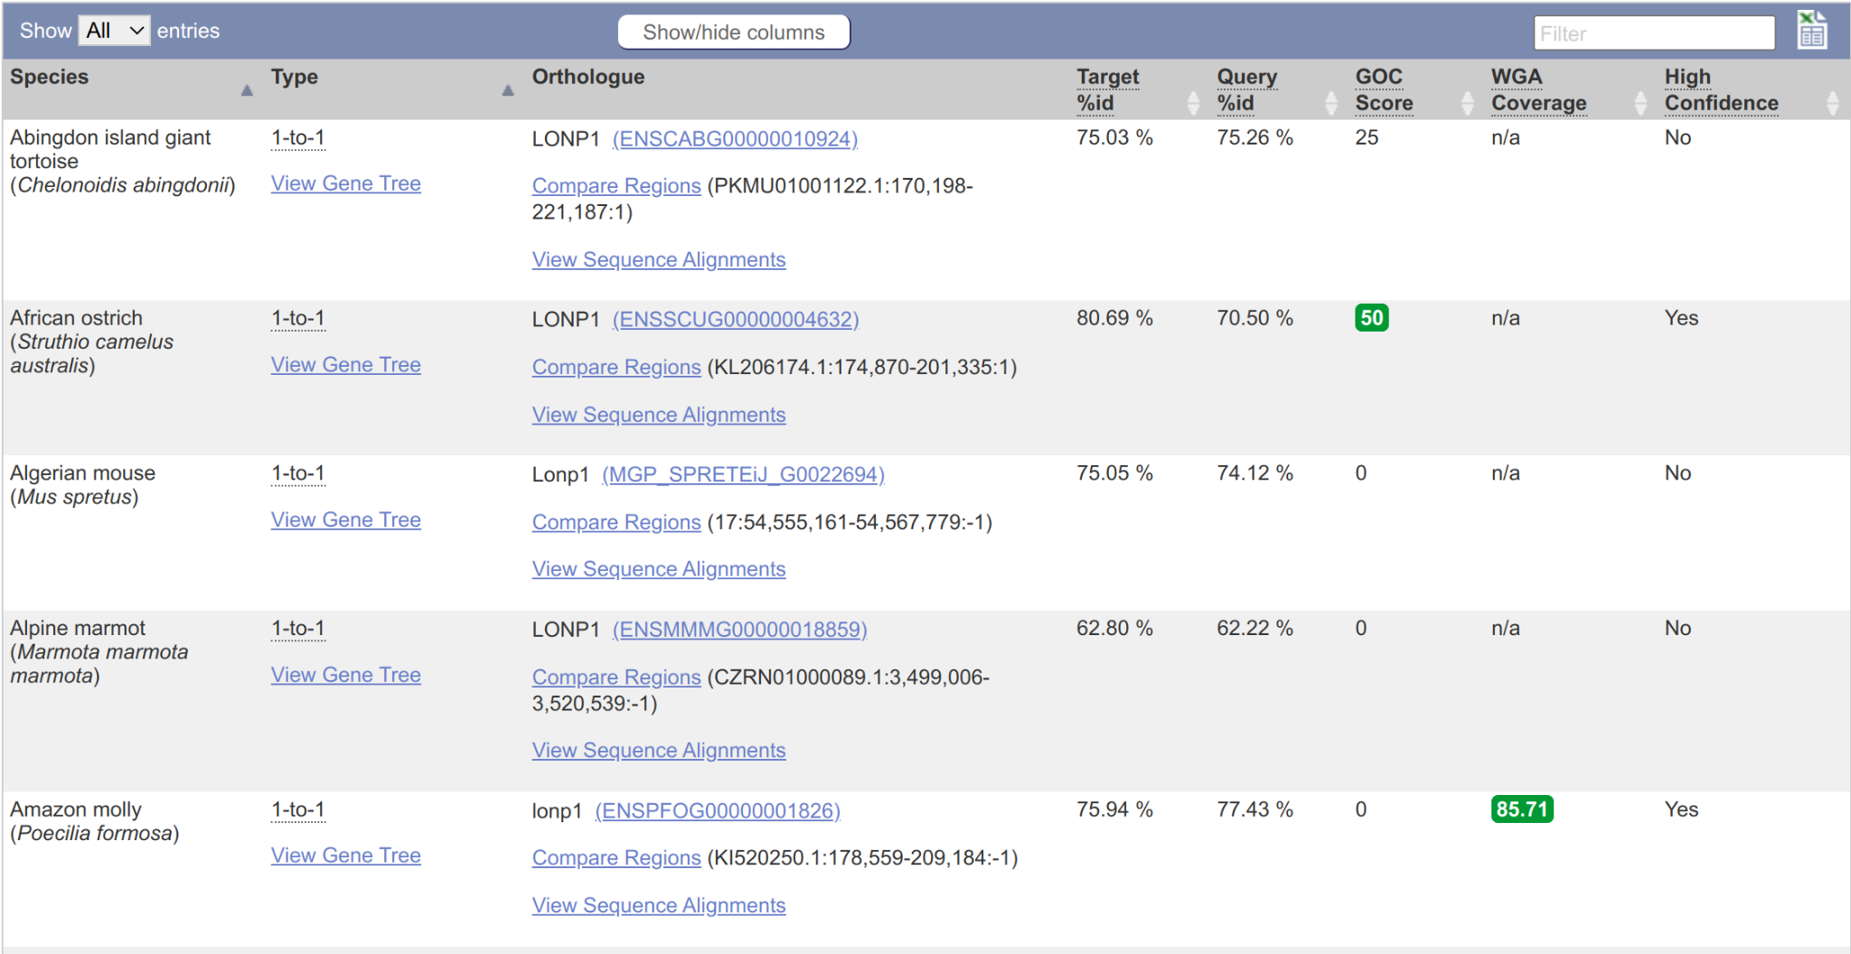
"Gene" Demo - Orthologues
Go to ENSDARG00000102765 and click on “Orthologues”
Notes:
From https://www.ensembl.org/Danio_rerio/Gene/Summary?align=2007;db=core;g=ENSDARG00000102765;r=22:3160447-3182965

Slide 43
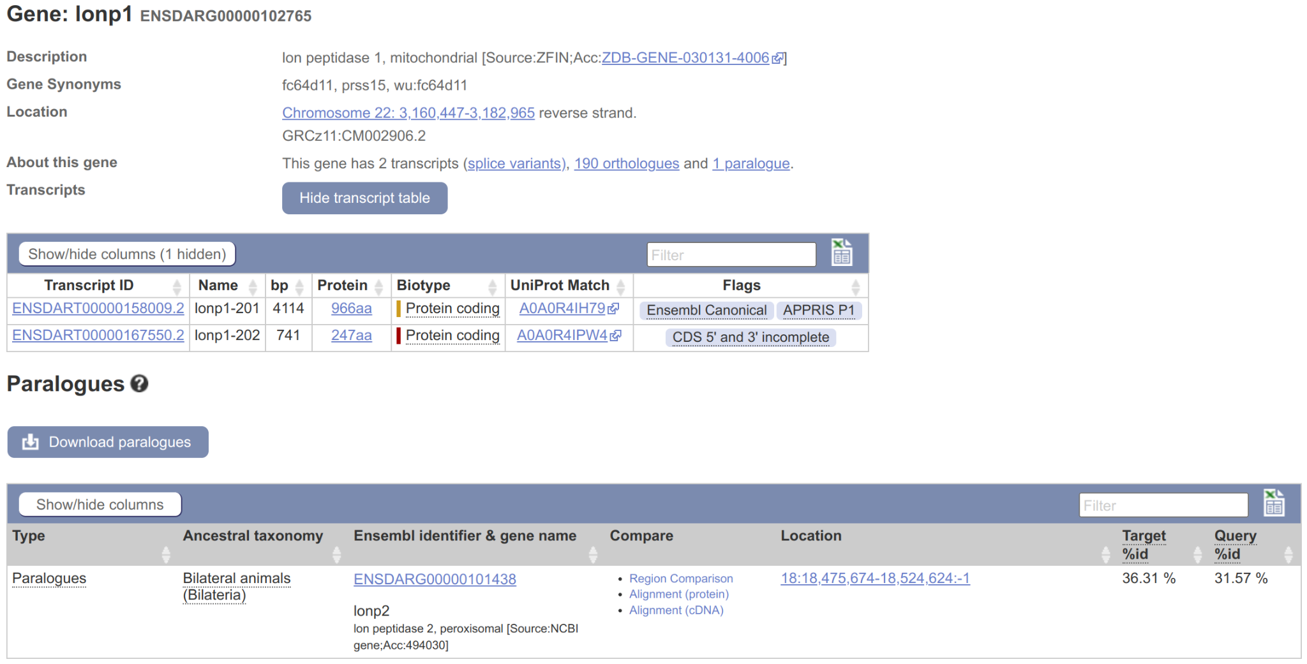
"Gene" Demo - Paralogues
Go to ENSDARG00000102765 and click on “Paralogues”
Notes:
From https://www.ensembl.org/Danio_rerio/Gene/Summary?align=2007;db=core;g=ENSDARG00000102765;r=22:3160447-3182965

Slide 44
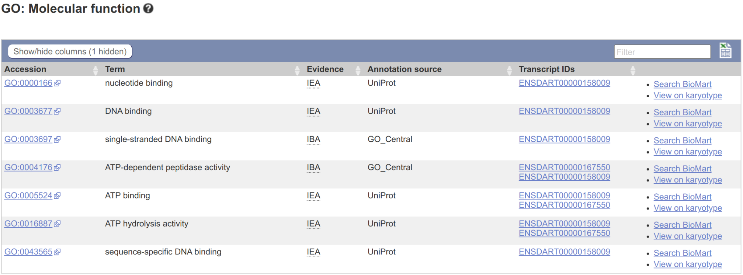
"Gene" Demo - GO Terms
Go to ENSDARG00000102765 and click on “GO: Molecular function”
Notes:
From https://www.ensembl.org/Danio_rerio/Gene/Summary?align=2007;db=core;g=ENSDARG00000102765;r=22:3160447-3182965

Slide 45
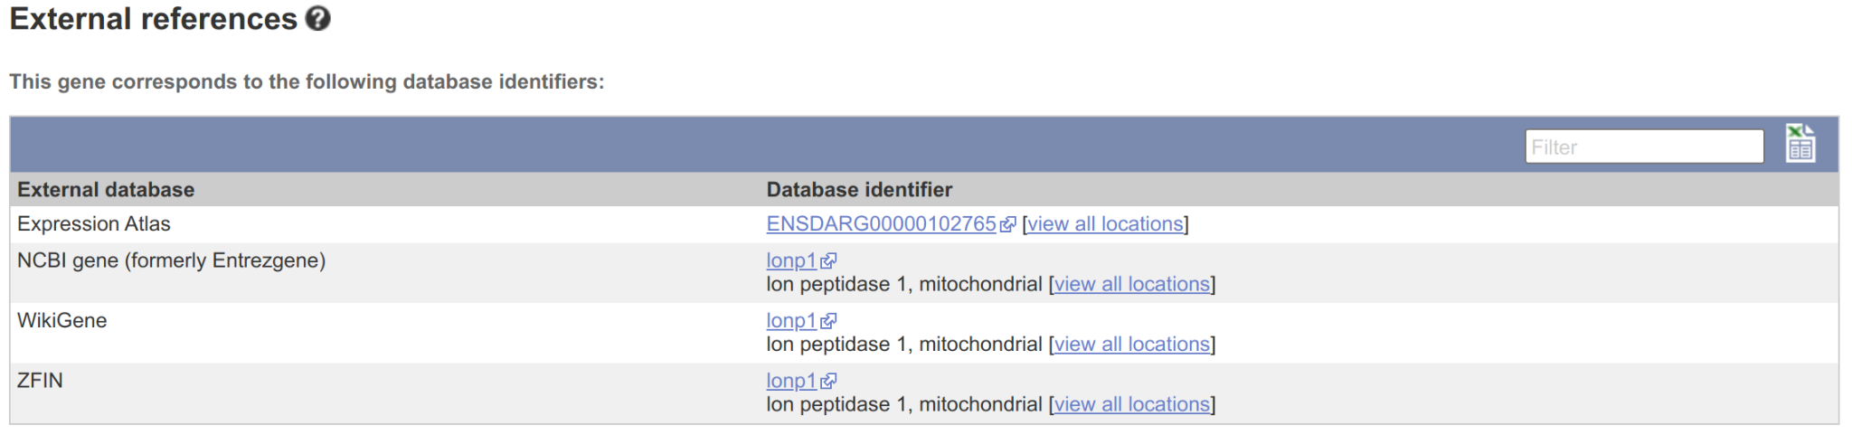
"Gene" Demo - External References
Go to ENSDARG00000102765 and click on “External references”
Notes:
From https://www.ensembl.org/Danio_rerio/Gene/Summary?align=2007;db=core;g=ENSDARG00000102765;r=22:3160447-3182965

Slide 46
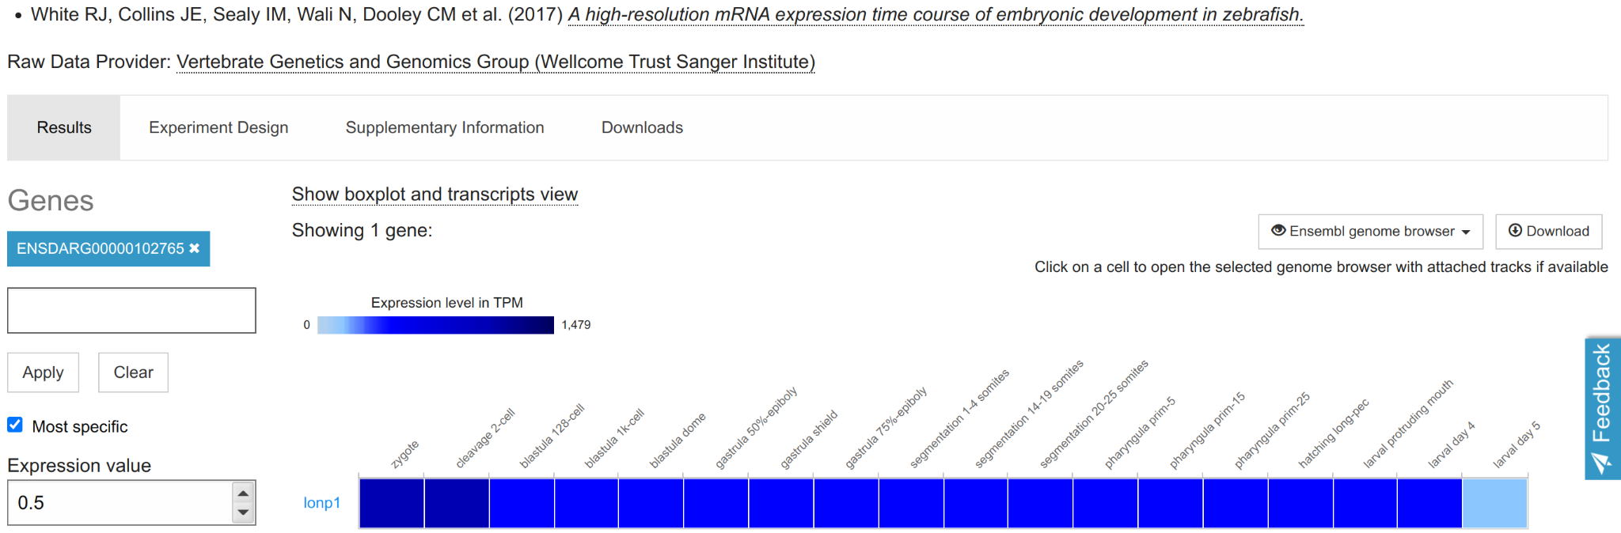
"Gene" Demo - Expression Atlas
From “External references” click “Expression Atlas” ID then “18 White et al”
Notes:
Note that clicking “18 White et al” shows stages in correct order
Note data come from our group’s embryonic development RNA-seq time course
Note can easily add more genes

Slide 47
Compara
Compara - produce Ensembl’s comparative genomics resources
Two types of analysis:
Gene level comparisons to produce gene trees, e.g. infer homologues (orthologues & paralogues)
Whole genome alignments - pairwise and multiple alignments, e.g. constrained elements and synteny
Notes:
Compara help info: https://www.ensembl.org/info/genome/compara/index.html

Slide 48
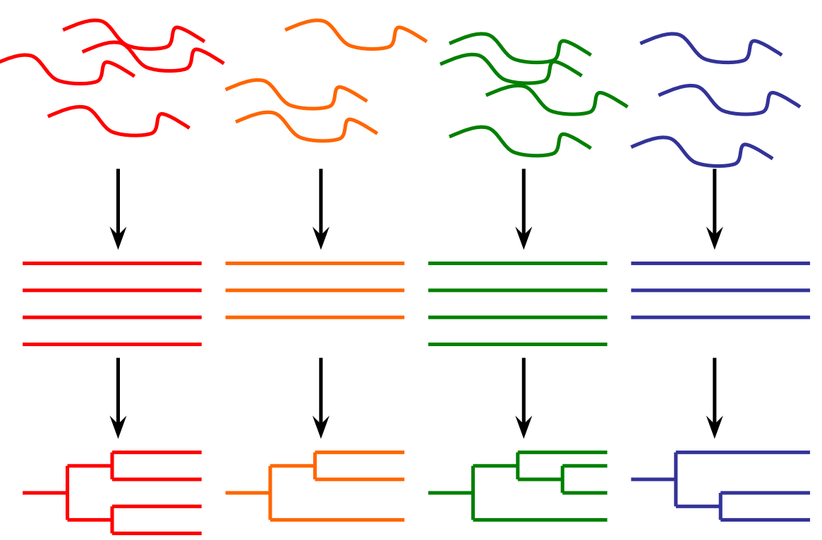
Compara - Gene Trees
Separate trees for proteins and ncRNAs (take secondary structure into account)
Process:
Take representative transcripts (e.g. longest CDS) from all genes from all species
Classify genes into clusters by TreeFam family
Build multiple alignment
Build gene tree reconciled with NCBI’s taxonomy tree
Infer orthologues and paralogues
Notes:
Note TreeFam defines gene families

Slide 49
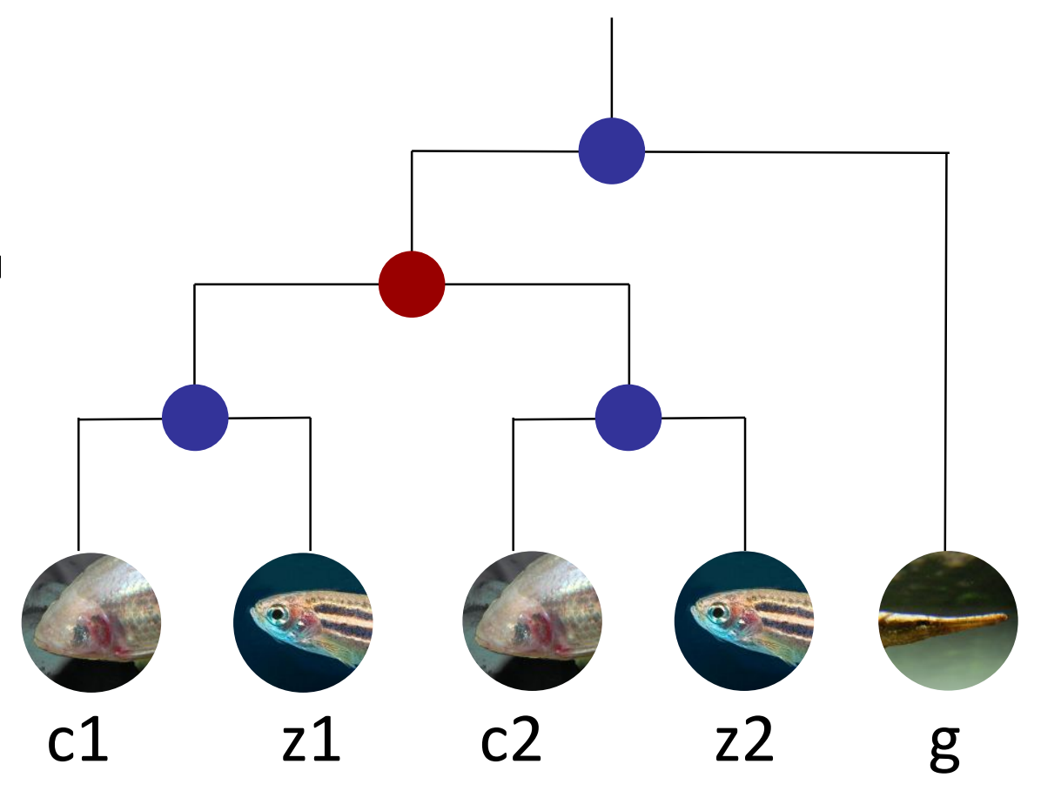
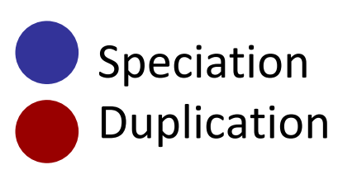
Compara - Infer Homologues (Orthologues & Paralogues)
z1 & z2 are paralogues (arose from duplication), as are c1 & c2
z1 & c1 are orthologues (arose from speciation), as are z2 & c2 + z2 & g, etc…
z1 & c1 have a one-to-one relationship
g has a one-to-many relationship to e.g. z1 and z2
Homologues labelled “high confidence” are supported by conservation of synteny or whole genome alignment blocks

Slide 50
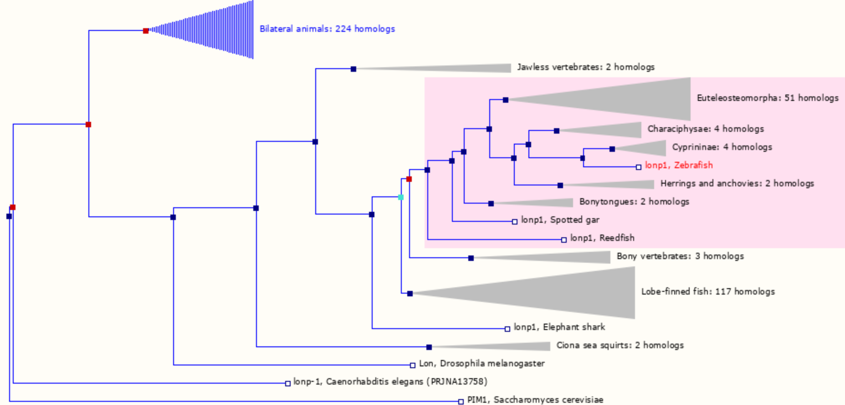
Compara - lonp1 Gene Tree
Mini-exercise: Go to lonp1 gene tree and expand/collapse subtrees to show both paralogs
Notes:
Note funnels are collapsed subtrees and can be clicked to expand them
Short exercise: Try and expand/collapse subtrees, such that you have both paralogs visible.

Slide 51
Problem with latest release
Due to an apparent production issue, many fewer genes in release 110 have ZFIN names
23,328 genes in release 109 have ZFIN names, but only 15,924 now
Meanwhile, only 164 genes in 109 had HGNC names, but now 3,113 do
(308 genes have names from miRBase in both 109 and 110)
Expect fix, but not until next release at the earliest (i.e. 3 or 4 months)
Affects all types of protein-coding genes, but a particular problem for paralogs...
Notes:
Note funnels are collapsed subtrees and can be clicked to expand them
Short exercise: Try and expand/collapse subtrees, such that you have both paralogs visible.

Slide 52
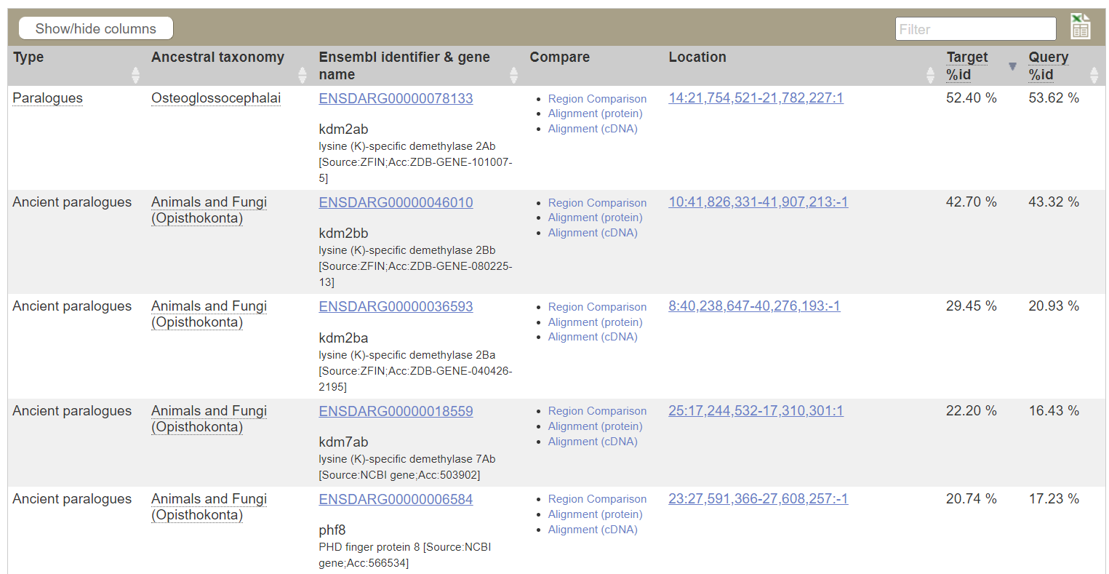
Problem with latest release
Teleost-specific paralogs are normally called a and b, e.g. kdm2aa and kdm2ab
Paralogs for kdm2aa in Ensembl release 109:
Notes:
Note funnels are collapsed subtrees and can be clicked to expand them
Short exercise: Try and expand/collapse subtrees, such that you have both paralogs visible.

Slide 53
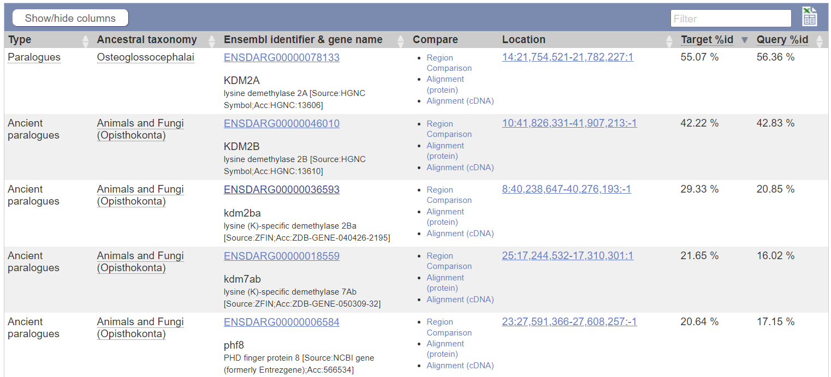
Problem with latest release
Teleost-specific paralogs are normally called a and b, e.g. kdm2aa and kdm2ab
Paralogs for kdm2aa in Ensembl release 110:
Notes:
Note funnels are collapsed subtrees and can be clicked to expand them
Short exercise: Try and expand/collapse subtrees, such that you have both paralogs visible.

Slide 54
Problem with latest release
Teleost-specific paralogs are normally called a and b, e.g. kdm2aa and kdm2ab
Paralogs for kdm2aa in Ensembl release 110:
Three problems:
Makes it unclear that a gene is a paralog
Violates nomenclature rules
Breaks link to ZFIN genes
Species | Gene | Protein
Zebrafish | shha | Shha
Human | SHH | SHH
Mouse | Shh | SHH

Slide 55
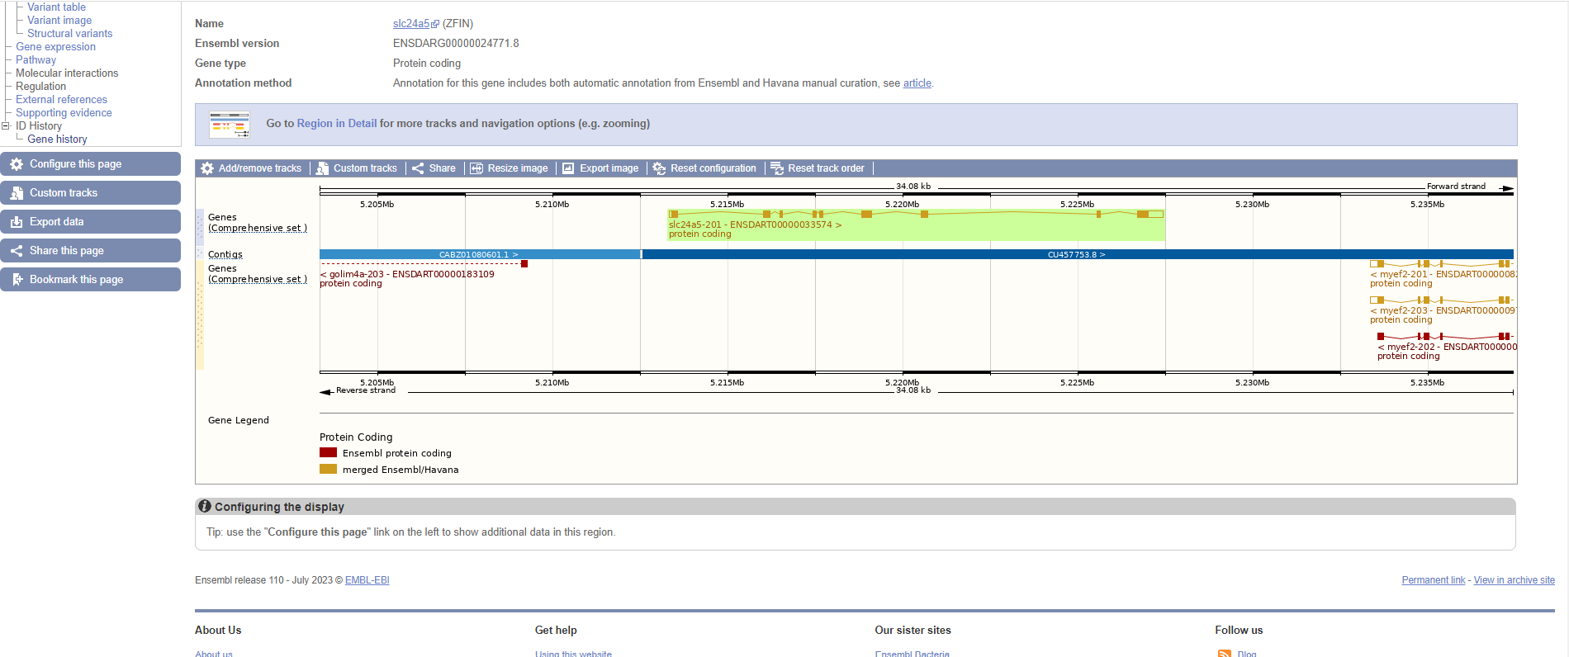
Problem with latest release
Accessing previous release:

Slide 56
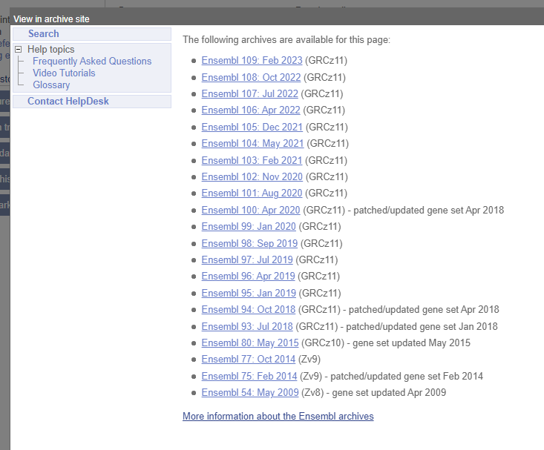
Problem with latest release
Accessing previous release:

Slide 57
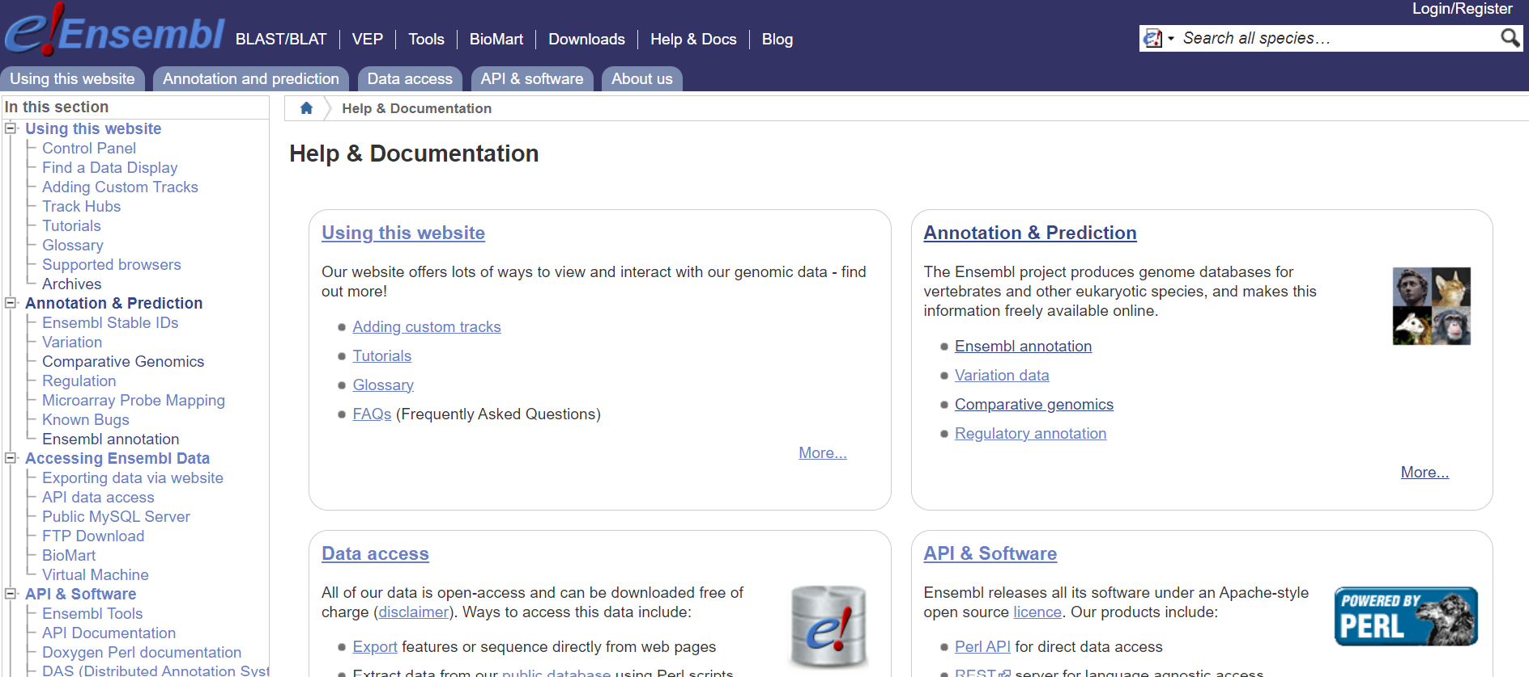
Problem with latest release
Accessing previous release:

Slide 58
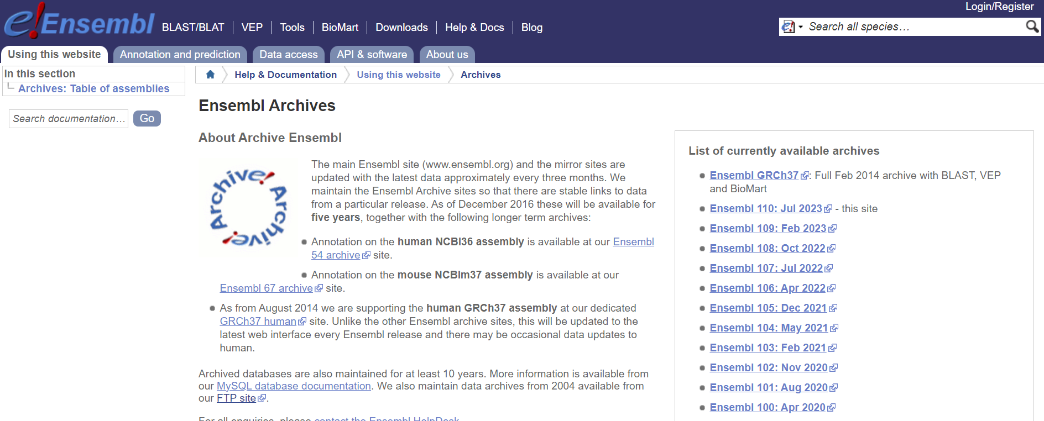
Problem with latest release
Accessing previous release:

Slide 59
Compara - Whole Genome Alignments
Pairwise whole genome alignments with LASTZ
Zebrafish has alignments to 64 species (plus itself)
Only human (180) and medaka (65) have more
Full list at: www.ensembl.org/info/genome/compara/analyses.html
Multiple genome alignments with EPO (Enredo, Pecan, Ortheus)
Zebrafish is in 2 alignments (out of 11 in Ensembl) - one of 39 fish and one of 65 fish
For lists of species, see: www.ensembl.org/info/genome/compara/multiple_genome_alignments.html

Slide 60
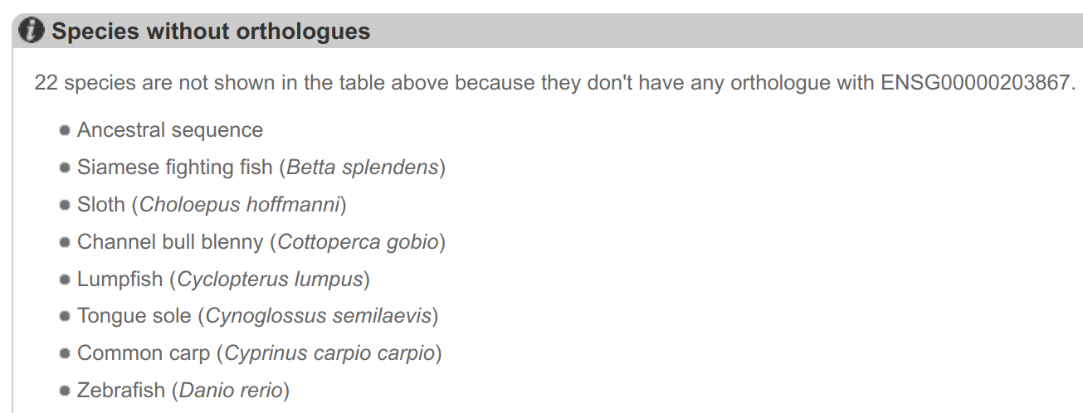
Synteny Example
No zebrafish orthologue listed for human RBM20 gene (ENSG00000203867)

Slide 61
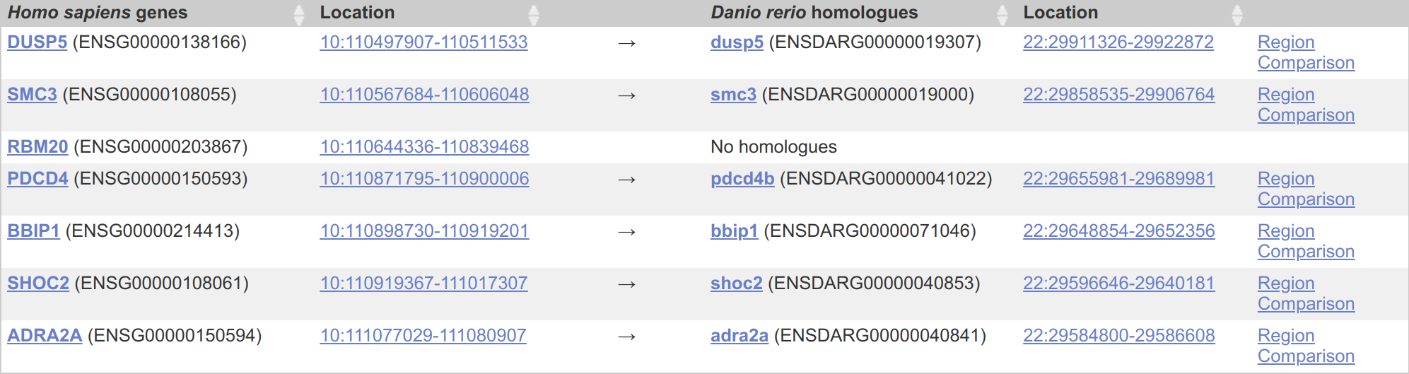
Synteny Example
If we look at the region around RBM20 in human and then click on Synteny we see conservation of synteny with zebrafish chr22

Slide 62
Synteny Example
If we look at the chr22 region in zebrafish then all the surrounding genes are the same and RBM20 is likely to be BX649294.1

Slide 63
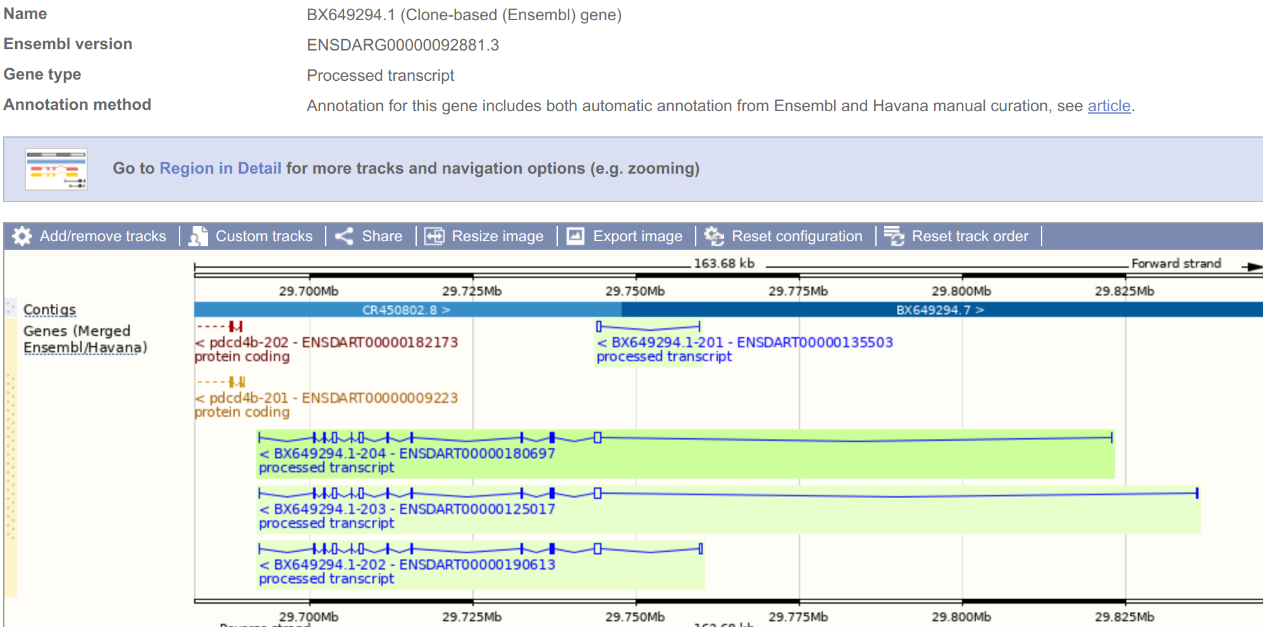
Synteny Example
Erroneously labelled as processed transcript and so not in protein gene tree, so not labelled as orthologue or named by orthology

Slide 64
Exercise 2
Do Exercise 2 - “exploring genes”
Covers:
Gene view
Phenotypes
Gene Ontology
Homologues
Gene trees
Synteny
Go to mbl2023.buschlab.org

Slide 65
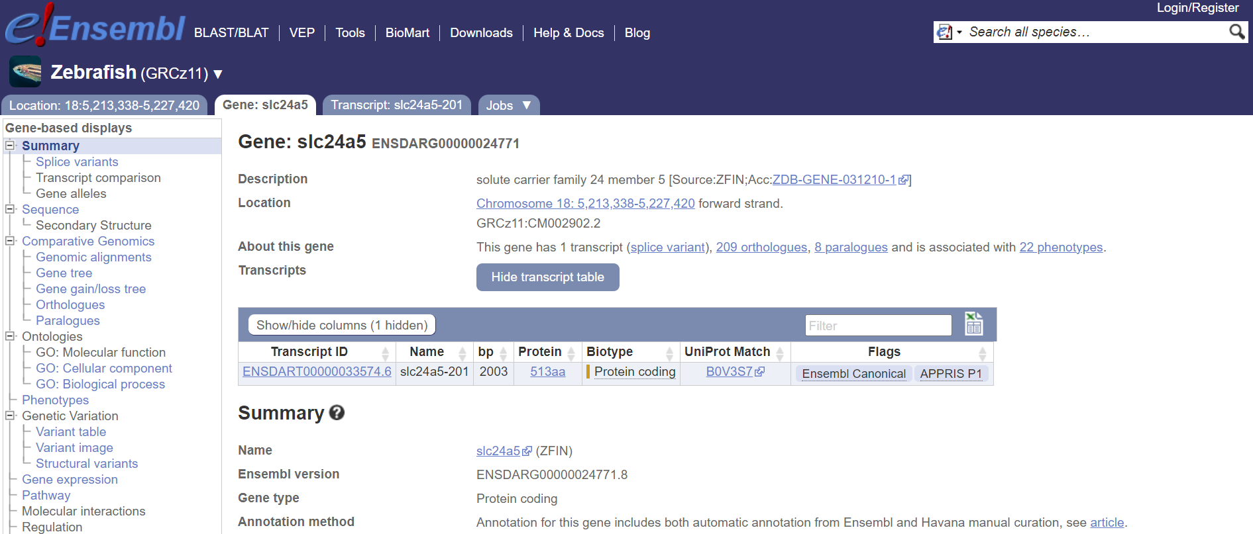
Summary overview of Ensembl Browser

Slide 66
Part 2 summary
Switching on additional tracks
Gene view
Comparative genomics
Learning outcomes:
Customise Ensembl tracks for your needs
Navigate gene view to find splice variants, exon tables, external data, etc
Identify orthologs and paralogs
Any questions?
Email me any questions that you think of later: e.busch-nentwich@qmul.ac.uk

Slide 67
Part 3 (Day 2)
BioMart
Other tools
Custom tracks
Before we start: Any questions from yesterday?

Slide 68
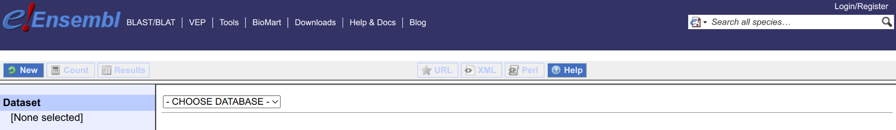
BioMart
Export (large amounts of) Ensembl data without programming
Completely customisable, but simple to make complex queries
Four stages:
Dataset
Filters
Attributes
Results

Slide 69
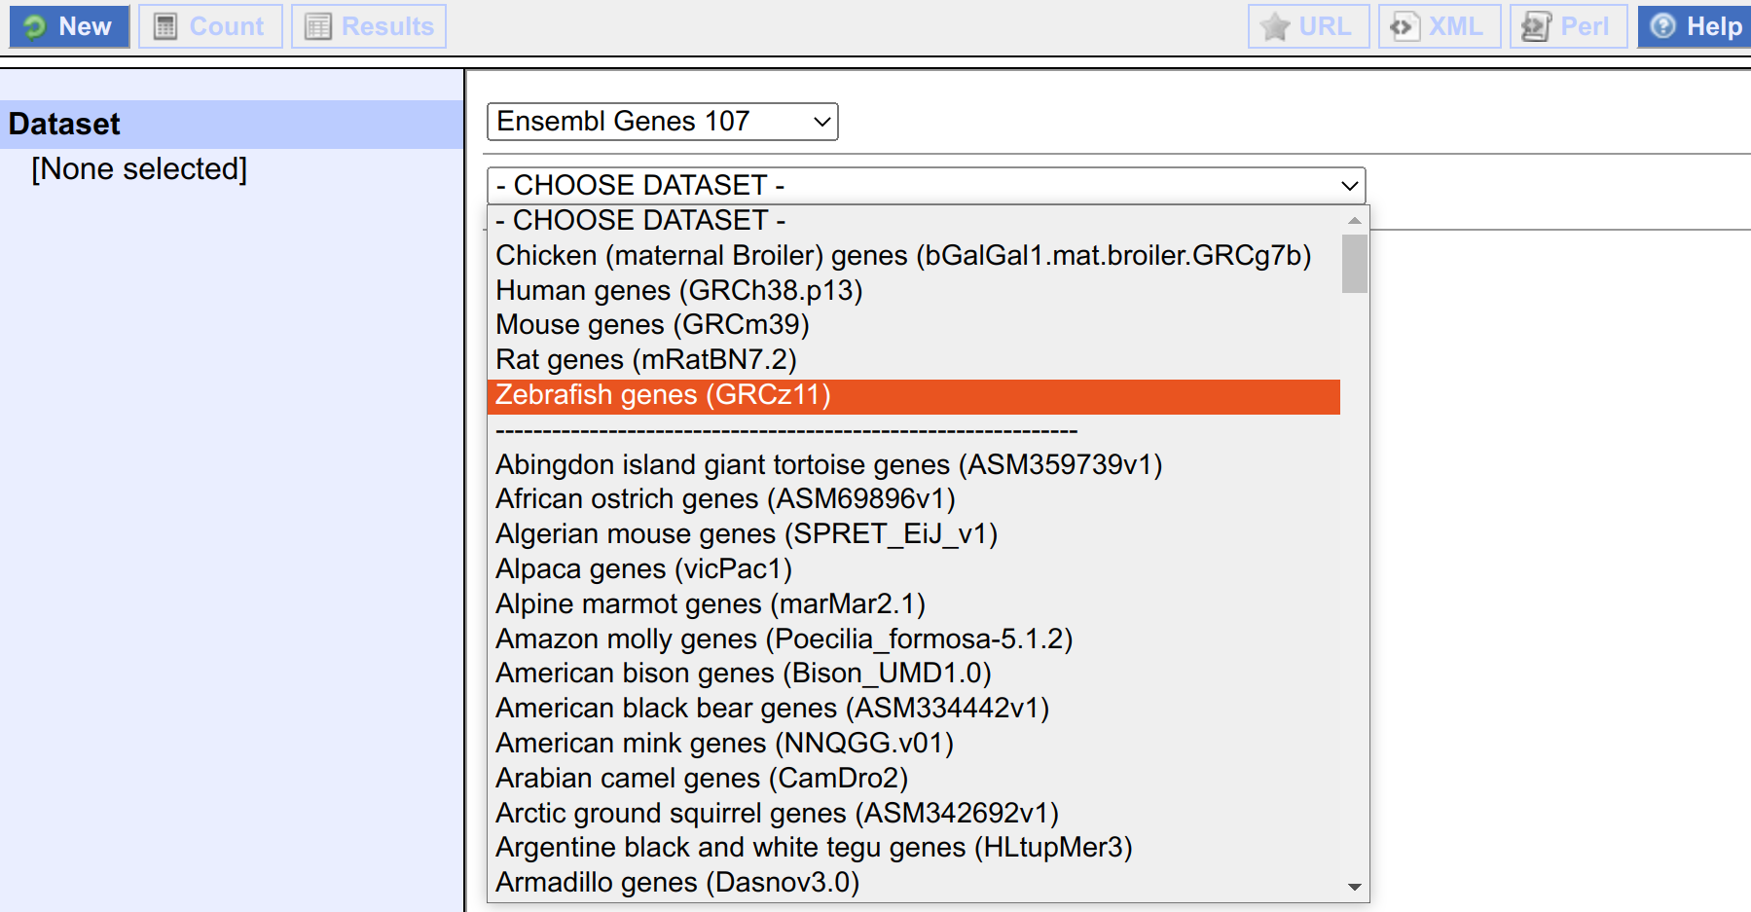
BioMart - Dataset
Choose database (e.g. genes or variants) and species
Notes:
Note the popular species at the top. And chicken.

Slide 70
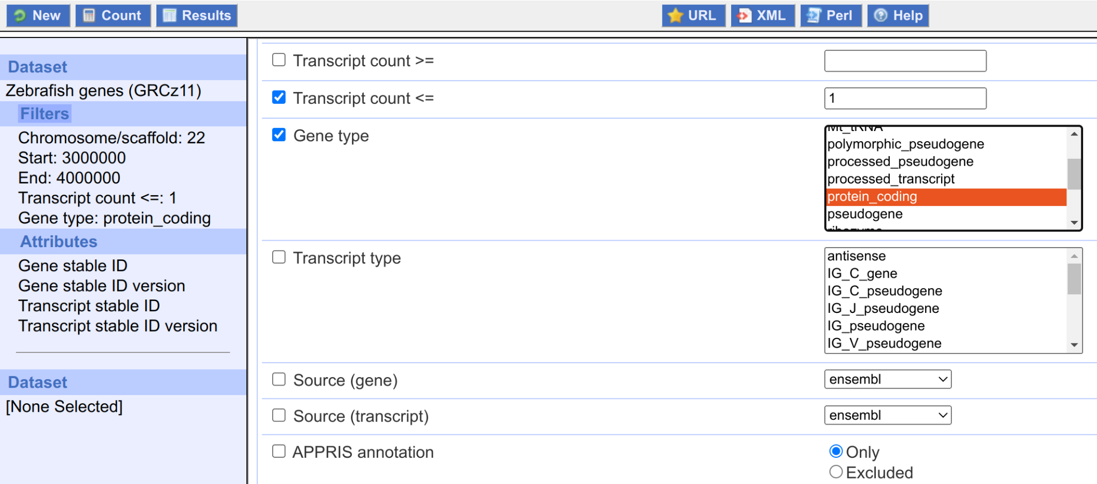
BioMart - Filters
Filter to reduce the dataset
Can select multiple filters
e.g. regions, IDs, GO terms, etc...
Notes:
Note can press Count at any time and see how many genes (or variants) remain after filtering

Slide 71
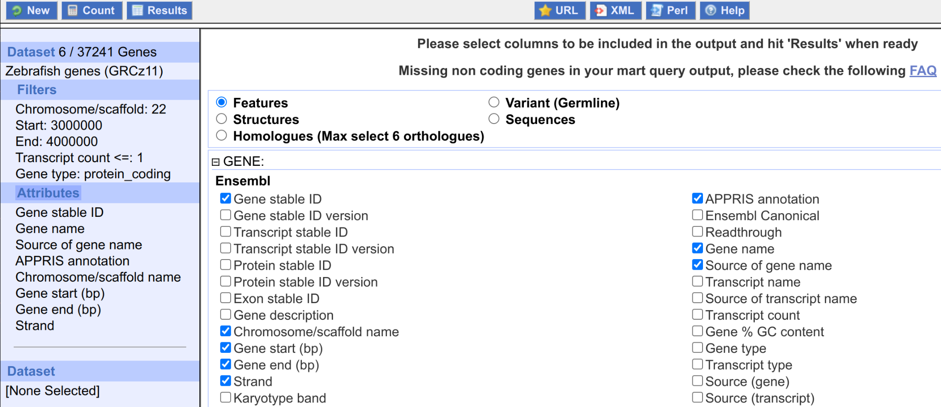
BioMart - Attributes
What data to export
e.g. IDs, genomic locations, sequences, homologues, etc...
Notes:
Note count is shown
Note attributes are listed in the output in the order they are selected here

Slide 72
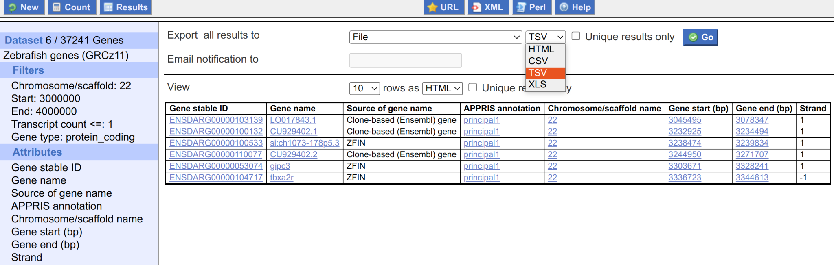
BioMart - Results
Access your selected data in multiple formats
e.g. HTML, TSV, CSV, XLS
Notes:
Note for big datasets can get an email notification when ready for download

Slide 73
Exercise 3
Do Exercise 3 - “CRISPR design”
Covers:
Using BioMart to download sequence
Designing and checking guideRNAs
Go to mbl2023.buschlab.org

Slide 74
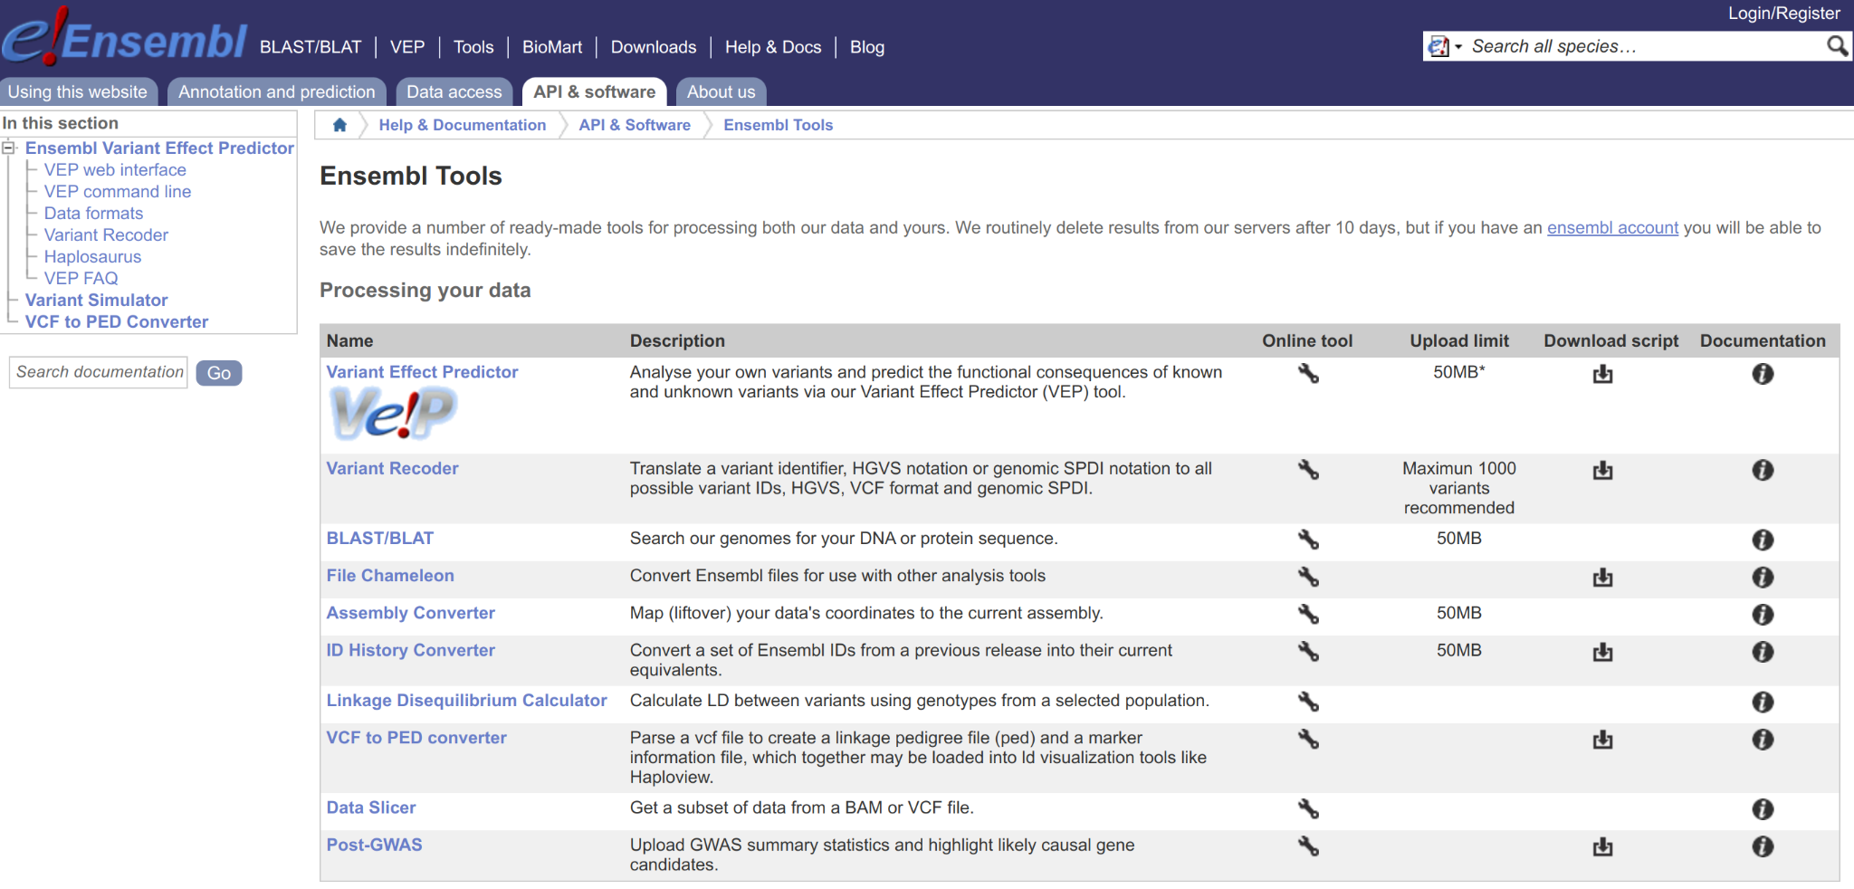
More Tools
Results from all tools can be stored indefinitely if you create an Ensembl account
Notes:
Note click on Save icon to store results
Note that saved data can also be shared with other users by making a group

Slide 75
Variant Effect Predictor
VEP predicts consequences of variants
www.ensembl.org/Danio_rerio/Tools/VEP
Example: 22 3169475 3169475 G/T 1 22 3169514 3169514 A/T 1 22 3166910 3166910 C/A 1 (Chr, Start, End, REF/ALT, Strand)
Custom Ensembl format, but standard formats like VCF can be used
Notes:
Note VEP is under Tools, but also has entry in top level Ensembl menu, like BLAST/BLAT
Note coordinates of induced mutations in lonp from ZMP

Slide 76
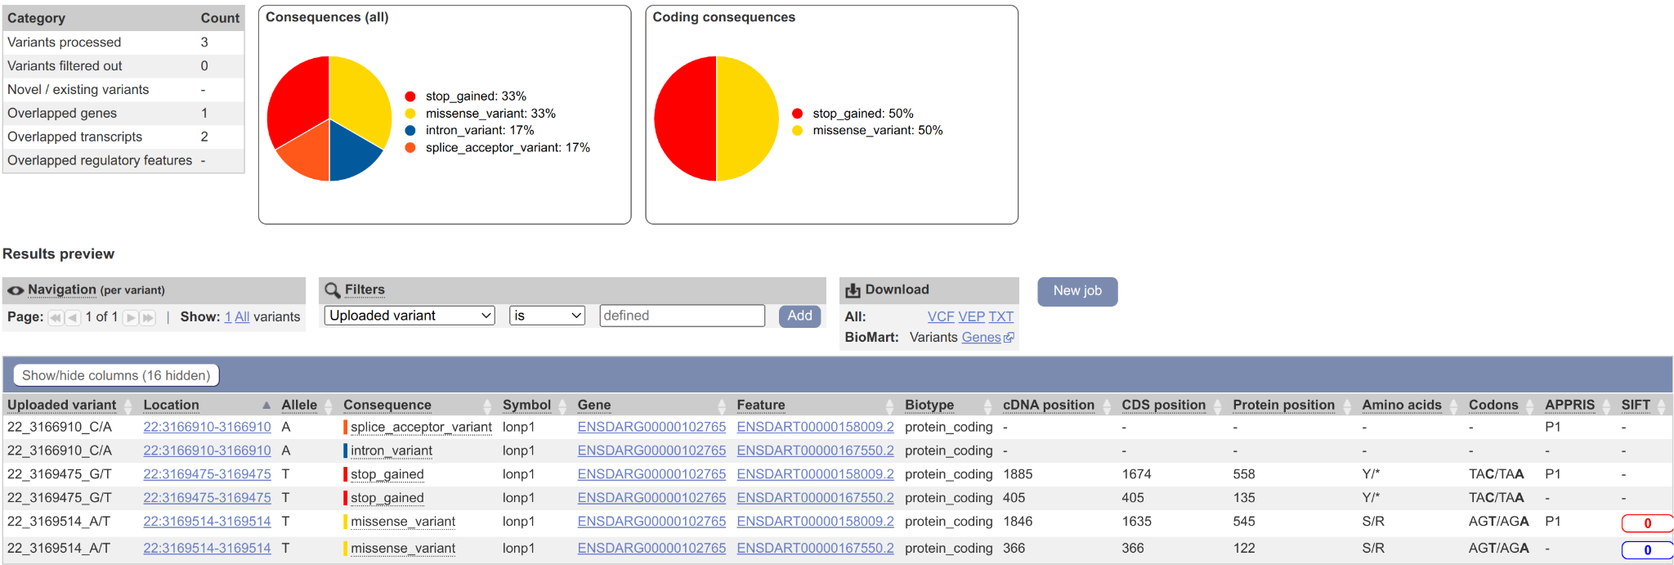
Variant Effect Predictor
Notes:
Note 0 for SIFT = deleterious; blue for SIFT = low confidence

Slide 77
Exercise 4
Do Exercise 4 - “exploring variation”
Covers:
Variant nomenclature
Variant Effect Predictor
Variant tables
Go to mbl2023.buschlab.org

Slide 78
Assembly Converter
Assembly Converter allows converting coordinates from one assembly to another
Also known as LiftOver
e.g. used for converting coordinates found in old papers
www.ensembl.org/Danio_rerio/Tools/AssemblyConverter
Example: 22 3144711 3144711 sa39354 22 3145013 3145013 sa43743 (Chr, Start, End, Name)
BED format: www.ensembl.org/info/website/upload/bed.html
(Only first three fields are essential)
Notes:
Note coordinates of mutations in lonp from ZMP

Slide 79
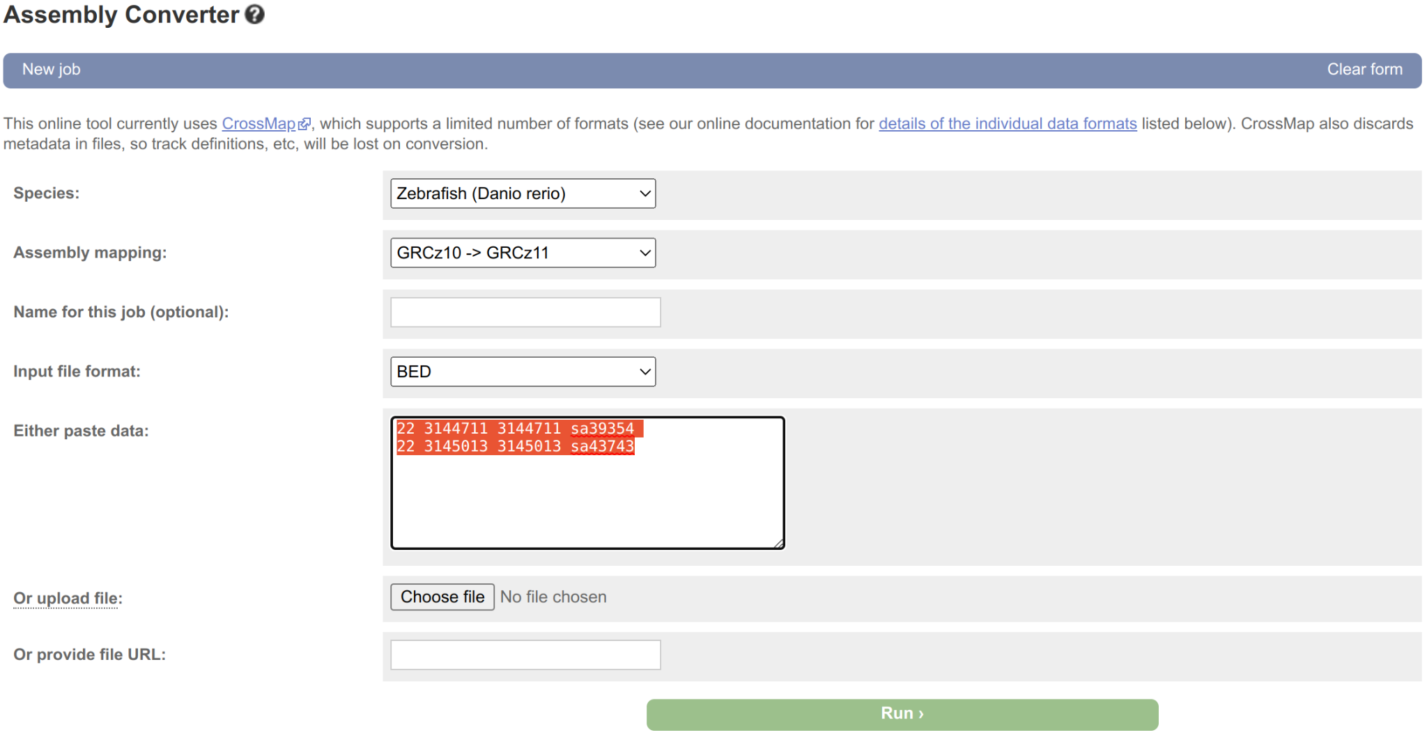
Assembly Converter

Slide 80
Assembly Converter
Input:
22 3144711 3144711 sa39354 22 3145013 3145013 sa43743
Output: 22 3161984 3161984 sa39354 22 3162286 3162286 sa43743
Notes:
Note that output is produced as a downloadable BED file
If converting only two coordinates then would probably use BLAST, but Assembly Converter can convert thousands of coordinates at a time

Slide 81
UCSC In-Silico PCR
Fast search for possible products from a pair of PCR primers
genome.ucsc.edu/cgi-bin/hgPcr
Notes:
Example primers: Left: CCCGGGGAGCAGTTTGAT
Right: CGTTGGGTGGAGTAGGTCTG

Slide 82
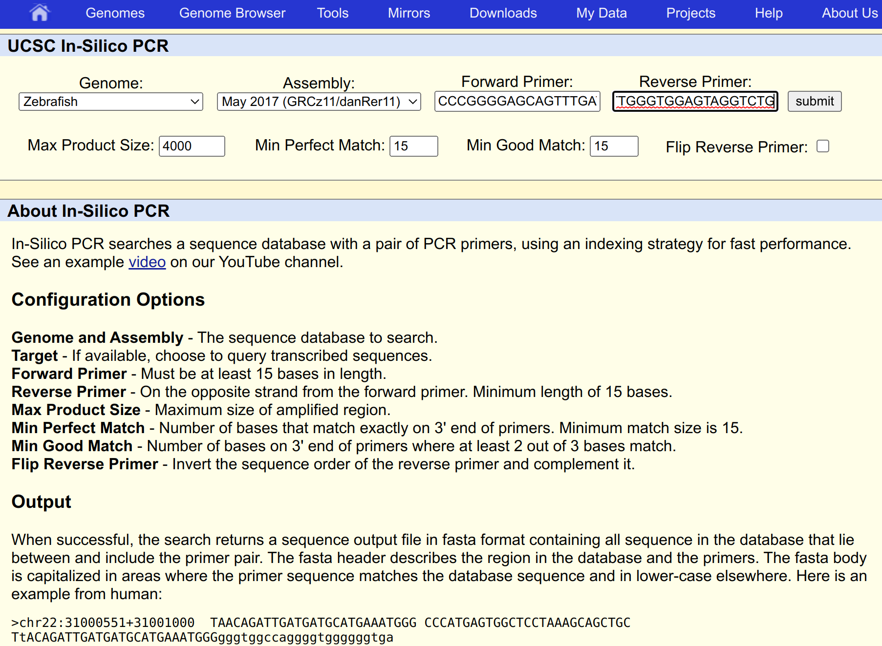
UCSC In-Silico PCR
Fast search for possible products from a pair of PCR primers
genome.ucsc.edu/cgi-bin/hgPcr

Slide 83

UCSC In-Silico PCR
Fast search for possible products from a pair of PCR primers
genome.ucsc.edu/cgi-bin/hgPcr
Notes:
Note two products in this case, but one is on alternative scaffold

Slide 84

UCSC & Ensembl Differences
Ensembl: 1 UCSC: chr1
Ensembl: 1-based coordinates (bases numbered) UCSC: 0-based coordinates (numbers between bases)
The G is 1:4-4 in Ensembl coordinates but 1:3-4 in UCSC

Slide 85

Custom Tracks
Click “Custom tracks” and add https://mbl2023.buschlab.org/data/3p-seq.bed
24 hpf 3P-Seq data from Bartel lab
Notes:
Add https://mbl2023.buschlab.org/data/3p-seq.bed
Originally downloaded from https://danio-code.zfin.org/files/annotated_files/3P-seq/DCD007025BS/danRer11.DCD007934DT_paracluOut.bed / https://danio-code.zfin.org/dataExport/daniocode/detailSeries/360/
3P-Seq data from 24 hpf from the Bartel lab
Tags 3’ ends: Poly(A)-Position Profiling by Sequencing

Slide 86

Custom Tracks
Go to "22:3153000-3217000" (reverse strand)
Notes:
Note tag supporting 3’ end of gold transcript, but not red transcript or any of the partial RNA-seq models
Also note tag not associated with any reverse strand gene (point out agreement with Lawson data later)
From https://www.ensembl.org/Danio_rerio/Location/View?r=22%3A3153000-3217000

Slide 87

Custom Tracks
Go to "22:3153000-3217000" (forward strand)
Notes:
Situation for rpl36 is more complex but largely agrees with known 3’ end and casts doubt on extended UTR of RNA-seq gene models
From https://www.ensembl.org/Danio_rerio/Location/View?r=22%3A3153000-3217000

Slide 88
Custom Tracks - Lawson Lab Annotation
Lawson et al. (2020) “An improved zebrafish transcriptome annotation for sensitive and comprehensive detection of cell type-specific genes” eLife 9:e55792
Aim: To unify discrepancies between Ensembl and RefSeq annotations

Slide 89

Custom Tracks - Lawson Lab Annotation
Lawson et al. (2020) “An improved zebrafish transcriptome annotation for sensitive and comprehensive detection of cell type-specific genes” eLife 9:e55792

Slide 90
Custom Tracks - Lawson Lab Annotation
Lawson et al. (2020) “An improved zebrafish transcriptome annotation for sensitive and comprehensive detection of cell type-specific genes” eLife 9:e55792
www.umassmed.edu/lawson-lab/reagents/zebrafish-transcriptome/
Add: https://www.umassmed.edu/globalassets/lawson-lab/downloadfiles/v4.3.2.gtf
Large, so Ensembl will be slow - disable or delete when done

Slide 91

Custom Tracks - Lawson Lab Annotation
Lawson et al. (2020) “An improved zebrafish transcriptome annotation for sensitive and comprehensive detection of cell type-specific genes” eLife 9:e55792
www.umassmed.edu/lawson-lab/reagents/zebrafish-transcriptome/
Add: https://www.umassmed.edu/globalassets/lawson-lab/downloadfiles/v4.3.2.gtf
Large, so Ensembl will be slow
Notes:
Note spurious 5’ exon in lonp1 that probably isn’t real since it overlaps a gene on the other strand
Also, a transcript supports the downstream 3P-Seq tag (and seems to have led to ftsj3 being erroneously placed on the reverse strand, even though the rest of its transcripts are on the forward strand)

Slide 92
Regulatory information
Ensembl integrates regulatory information from a variety of genome-wide assays (e.g. ChIP-seq and DNase-seq)
But only has annotation for a limited set of species (mainly human and mouse, but also pig, chicken and some fish)
Not zebrafish
Instead have DANIO-CODE, a compendium of functional genomics datasets: https://danio-code.zfin.org/
Datasets submitted to DANIO-CODE can be visualised in Ensembl (and UCSC)

Slide 93
Regulatory information
For Ensembl, add a custom track using the DANIO-CODE track hub: https://danio-code.zfin.org/trackhub/DANIO-CODE.hub.txt
(You will need to select "Track Hub" for the data format.)
Does make Ensembl quite slow, even with just the default tracks displayed
Instead, could use UCSC by following instructions at: https://danio-code.zfin.org/help/

Slide 94

Regulatory information
For Ensembl, add a custom track using the DANIO-CODE track hub: https://danio-code.zfin.org/trackhub/DANIO-CODE.hub.txt
(You will need to select "Track Hub" for the data format.)
Does make Ensembl quite slow, even with just the default tracks displayed
Instead, could use UCSC by following instructions at: https://danio-code.zfin.org/help/

Slide 95
Exercise 5
Do Exercise 5 - “exploring data”
Covers:
BioMart
Making BED files
Finding candidate genes
Finding orthologues
Go to mbl2023.buschlab.org

Slide 96
Part 3 Summary
BioMart
Other tools
Custom tracks
Learning outcomes:
Use BioMart to download data
Analyse variants
Making BED files
Upload custom tracks

Slide 97
Thank You!
Any questions?

